Slide 1


Shape the future by solving problems
Pick a problem,
search for a solution,
and get involved
Where could engineering take you?

Slide 2

Where could engineering take you?
Notes:
Introduce yourself and what you do. Also if you feel comfortable include a little personal trait ie: I also sell homemade products at markets, I used to play saxophone in a band, something interesting about yourself.

Slide 3





What could YOU be?
Planet cleaner
Star maker
Cancer crusher
Robot ruler
Sustainability hero
Material manipulator
Time traveller
Problem Solver
HIGH SCHOOL
Notes:
Your aim: inspire kids about the big-picture of why engineering matters, and how engineers shape the future...without using the word ‘engineering’ in this slide.
Choose an application of engineering, and describe the person who does this without saying ‘engineer’:
Improving the environment
Curing cancer
Building roads, bridges and skyscrapers
Inventing a sustainable future
How do you get there? Choosing the right foundations at school.
What sets you up to be a problem solver? A strong technical/science background.

Slide 4
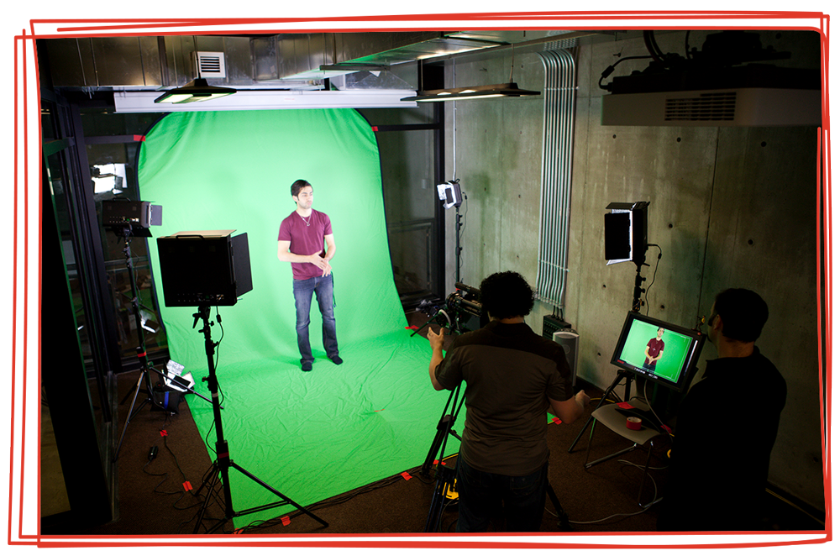






Shape the future
Pick a problem.
Find a solution.
Get involved.
HIGH SCHOOL
Notes:
Your aim: connect engineering disciplines with answers to real-life problems that could shape the future.
Part 1: What are the boundary-pushing ideas in your area of engineering?
These ideas are brought to you by problem solving.
Part 2: Think of a practical problem solving example that relates to:
Electrical engineering
Mechanical engineering
Chemical engineering
Civil engineering
The takeaway - math, science and engineering subjects are the pathway to solving these problems.

Slide 5

Notes:
Your aim: illustrate how engineering touches nearly every aspect of modern-day life.
Using a ‘day-in-the-life’ approach, what things have you done so far today that are thanks to engineering?
Examples:
Using Wi-Fi
Roadworks
Electric vehicles
GPS
<1:04 video>
The takeaway - engineers contribute to almost every aspect of our lives.

Slide 6


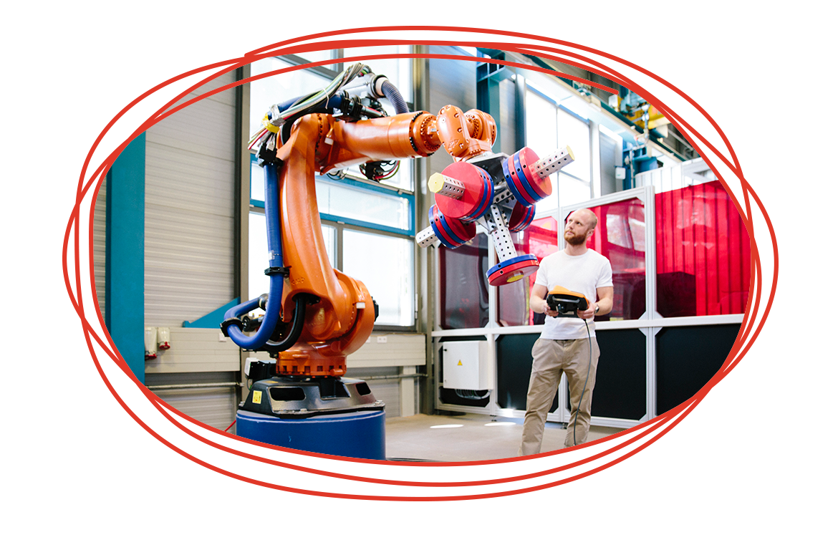

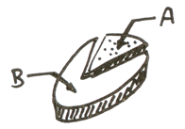
8 reasons to consider engineering
Create and shape the future
Make great money
Get a job straight after uni
Work in any industry, anywhere
Never stop learning
Beat the stereotypes
Travel the world
Solve problems all day, every day
HIGH SCHOOL
Notes:
Your aim: put engineering into a context that the students can picture themselves in.
Game time - the aim is for students to start sitting down, and stand up if they can answer yes to a statement.
Test statement: Your hair is brown <there will always be one clown that stands up at the wrong time, have a laugh if you get one of these!>
Real statements:
When you start something, you want to finish it.
You want to contribute to making the world better.
You want the freedom to work anywhere in the world.
You question things - you’ve been in trouble for asking ‘why’ too many times.
You like problems that have a definite answer (like ‘what is 2+2’, rather than ‘describe a perfect lunch’.)
You had a thing for LEGO or Minecraft.
You want to earn a good living.
At the end of the game, hopefully all students are standing - and these are future potential engineers.
Read through the 8 reasons to consider engineering, adding context/questions aimed at these students.
The takeaway - engineering is a career path that may suit you.

Slide 7






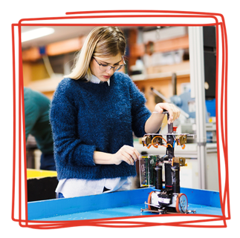
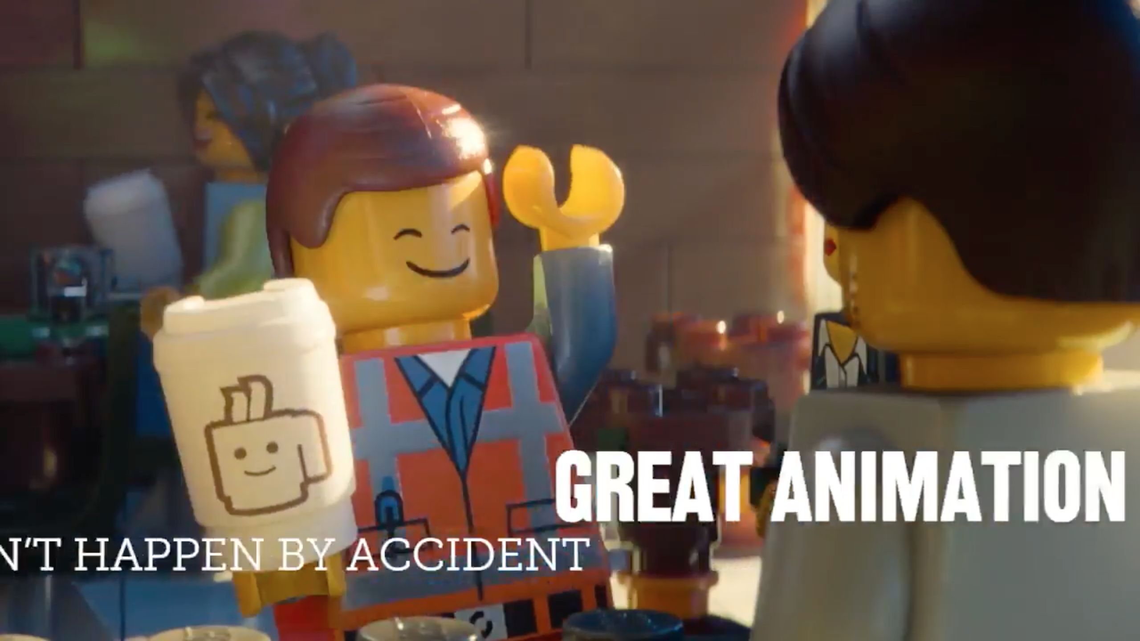

More than lab coats and geek glasses
Makeup = chemical engineer
Music = audio engineer
Cars = mechanical engineer
VFX + Animation = electrical engineer
HIGH SCHOOL
Notes:
Your aim: point out engineering careers that transcend stereotypes. Feel free to insert your own examples!
Breaking the stereotypes - consider what interests a teenager might have, and how they might relate to engineering.
Makeup (chemical engineering)
Music (audio engineering)
Cars (mechanical engineering)
VFX + Animation (electrical engineering): “Are you a wiz at maths and science and are you also in awe of films with great VFX and animation? Maybe you can make the next Oscar winning animated film, like Guy Griffiths.”
<Click on Lego Movie image to show Guy Griffiths video>
The takeaway - your interest can easily translate into a career in engineering.

Slide 8




What makes a good engineer?
Creativity
Critical thinking
Collaboration
Communication
HIGH SCHOOL
Notes:
Your aim: help the students understand the ‘soft skills’ that make a great engineer.
Optional question/answer activity (if you’ve got a warm audience!) - what do you think would make a good problem solver?
Direct students towards answers like:
Imagination
Communicating your thoughts on paper/to people
Sketching
Research
Detail-orientation
Critical thinking
All of these things also make a great engineer.
The takeaway - engineering is more than just technical skill.

Slide 9

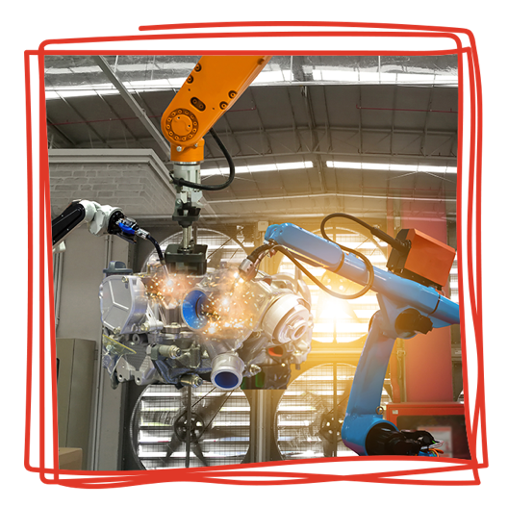

Choose your own adventure
HIGH SCHOOL + UNI
Science (Physics + Chemistry) + Math
Creative/communication subjects,
such as English
ALTERNATIVE PATHWAYS
Enabling courses
Other related courses at university
TAFE/colleges/PIBT/V.E.T.
Defence
HIGH SCHOOL
Notes:
Your aim: bust the myth that getting a high ATAR score and going to university is the only way to become an engineer.
Time to share - how did you get to be where you are? Traditional study, a gap year, alternative entry pathways?
Outline the ways to get to a graduate engineer position:
Straight from school
Via enabling courses
Transferring from a related course
TAFE engineering-based courses
Defence traineeships
The takeaway - if you want it, there are ways to make it a reality.

Slide 10




You can’t spell TEAM without…
Tradespeople,
technicians, technologists
Engineers
Associates
Me!
HIGH SCHOOL
Notes:
Your aim: widen perceptions of who’s in a team of engineers.
What are the different roles in a team of engineers?
Explain what the difference is between:
Tradespeople
Technicians/technologists
Engineers
Associates
Finally, what role do you play as an engineer?
The takeaway - even if you’re not an engineer, working alongside them is a great way to spend a career.

Slide 11
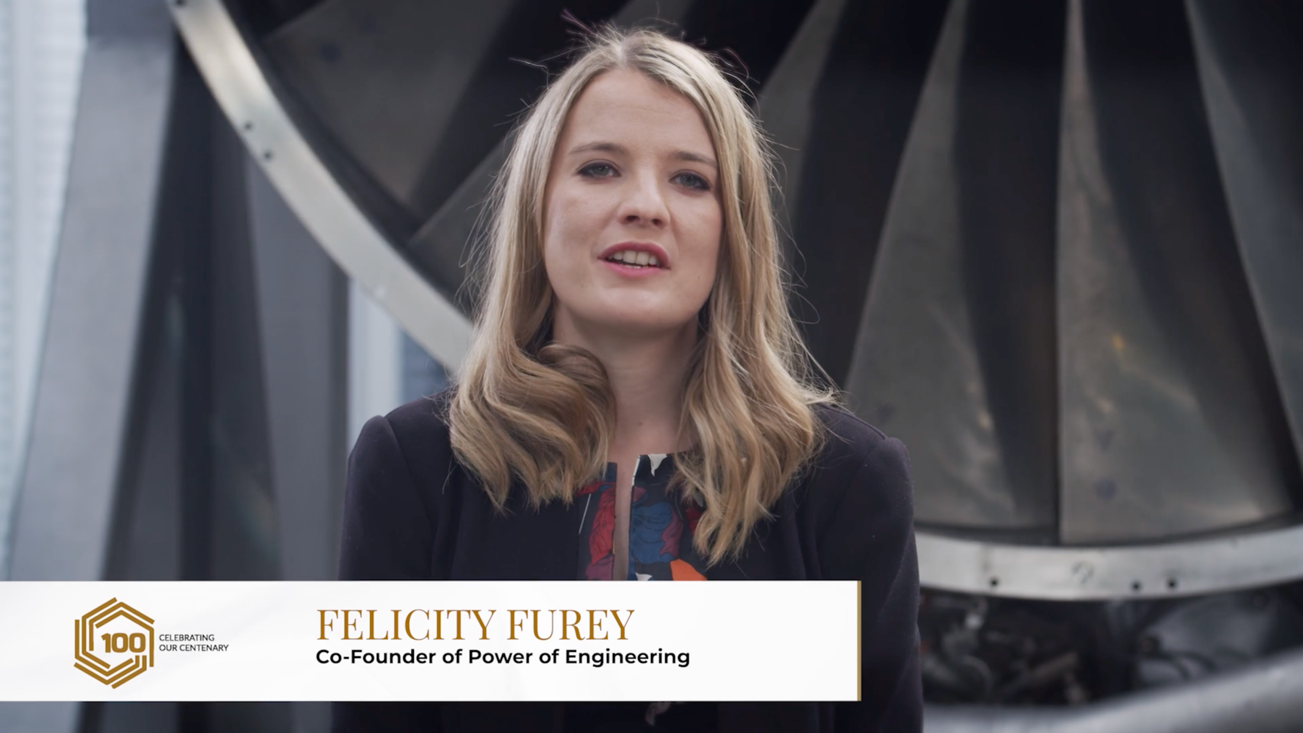
Notes:
Your aim: introduce the video and generate some interaction.
Felicity Furey is working to change the stereotypes in engineering, alongside engineers like Renee. Let’s take a look…
<4:20 video>

Slide 12

Notes:
Your aim: introduce the video and generate some interaction.
Building a Formula 1 car sounds like a lot of work, right? Well, a bunch of people your age have done exactly that, thanks to the F1 in Schools challenge. A team from Australia won the competition in 2018 - let’s take a look.
<3:19 video>

Slide 13



Engineering groups and events
Powerofengineering.org
rea.org.au/f1-in-schools
starportal.edu.au
dayofstem.com.au
HIGH SCHOOL
Notes:
Wrap-up time - discuss how students can get involved with engineering:
Do you want to explore engineering? There are plenty of ways to get involved.
Here are some projects that you can get involved with through school:
Power of Engineering
The Power of Engineering project holds one-day events for Year 9 and 10 students around Australia.
F1 in Schools
This is a worldwide competition with 17,000 students racing to develop the fastest miniature Formula 1 car.
If you want to explore engineering on your own:
STARportal
This site is full of free and low-cost STEM activities. Log on and discover a world of online and home-based activities to spark your curiosity.
Day of STEM
A free online resource that lets you experience what a day in the life of a STEM career might look like.
There’s plenty out there, but what can you do now?
Start thinking about the problems you want to solve
There are programs and grants out there, so get involved now
Keep your head in the game - turn up, every day
What’s your passion? Learn all about it
Leave them with something inspirational they can do today to move towards a future as an engineer.

Slide 14

