Slide 1
Teacher Development Program
Bringing schools and Engineering together
Year 11 – Engineering Fundamentals Module
Notes:
Please replace the text and image for your presentation. The image will need to be “sent to the back” by right clicking and selecting Arrange.

Slide 2
Teacher Development Program
Bringing schools and engineering together
INTRODUCTION – Engineering Fundamentals
The teacher development program provides current, industry related engineering context to the HSC engineering studies course.
This module is part of a series of 8 modules providing relevant material to the course learning outcomes.
The presentations provide a forum for teaches to network and interact with Engineers Australia.
WE AIM TO BE A FACILITATOR IN SUPPORTING YOU.

Slide 3
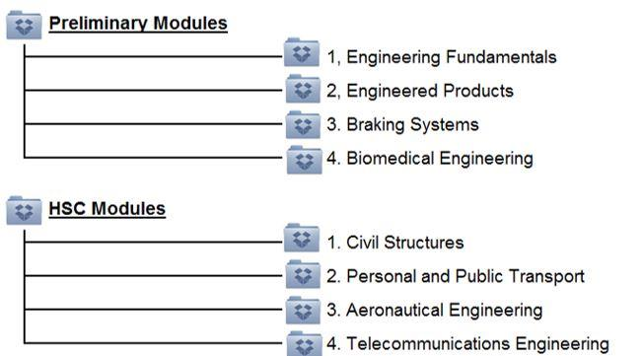

Teacher Development Program
Bringing schools and engineering together
Drop box
We have created an “ENGINEERING STUDIES RESOURCE CENTRE” on Dropbox.
This can be used by Teachers and Engineers Australia to share and communicate useful resources.
This Module

Slide 4
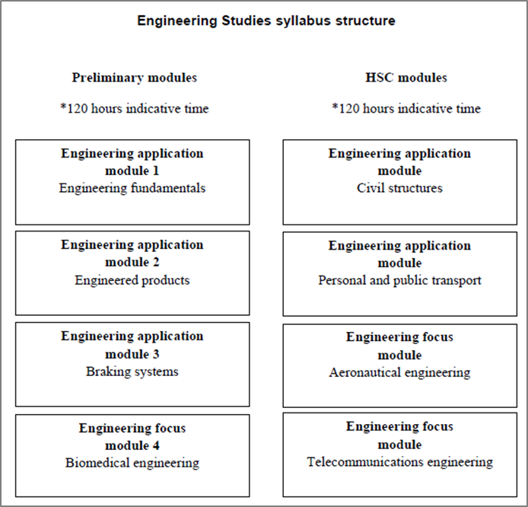
This Module

Slide 5
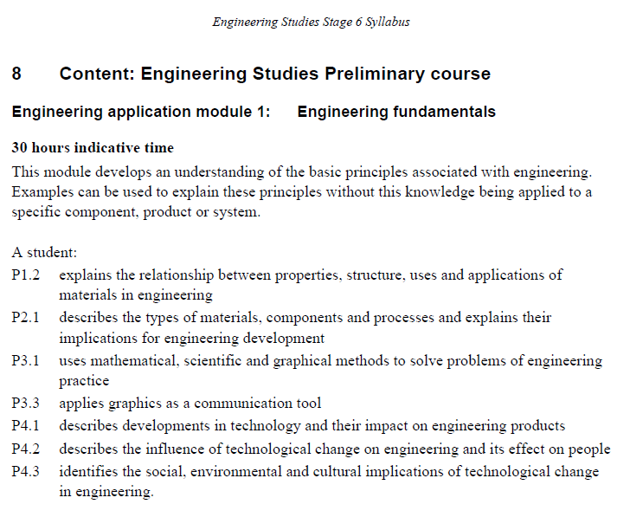
The Syllabus-Preliminary Modules
Student Learnings
Notes:
Please replace the text only for your body slides – do not delete the background image with the EA logo.

Slide 6

Content
History of Engineering
Engineering Discipline
Engineering Materials (in construction)
Case studies

Slide 7
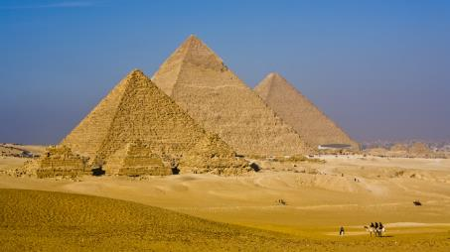
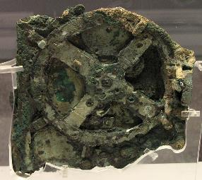
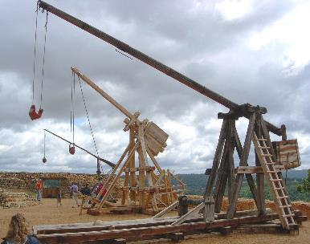

History of Engineering
Ancient:
Middle Ages:
Notes:
Pyramids: Egyptian monumental structures dating as far back as 2630BC. Large masonry structures using the wide base theory for support and stability.
Antikythera mechanism: Greek analogue computer dated back to between 100 and 150BC. Used to predict astronomical positions and eclipses. It was also able to track the four year cycle of the Olympiad.
Trebuchet: A military siege engine from early AD designed to hurl projectiles utilizing a counterweight and large lever arm.
Candle Clock: Developed by Al Jazari (Muslim mathematician from 1100 AD) to tell the time by burning a candle of known burning rate such that a counterweight would raise the candle as its mass decreased. And thus indicated the time by the candles position. He was also responsible for the development of some of the very first water pumps, allowing water to be transported uphill.

Slide 8
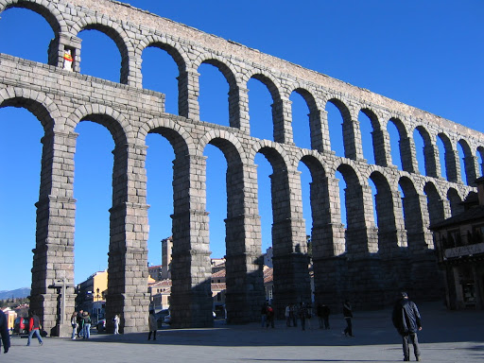
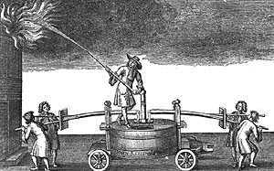

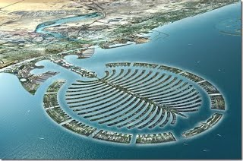


History of Engineering
Renaissance:
Modern Era:
Notes:
In the 17th century fire engine would have weighed up to a tonne. This period aas the beginning of the industrial revolution and made mass production a reality.
Engineering began to rise as a popular profession in the 18th century and some disciplines began to emerge such as mechanical engineering. Prior to this military and civil engineering were the broad encompassing disciplines.
Now engineering is an integral part of society and the input of engineers can be seen in nearly everything around you from your car, phone, house, roads and toothpaste.

Slide 9
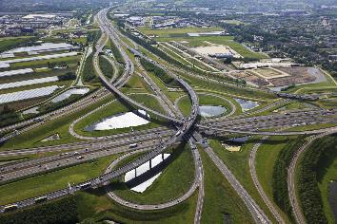
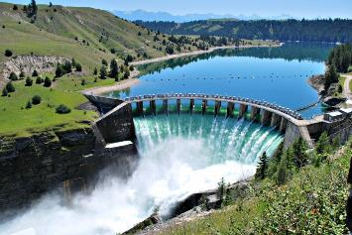
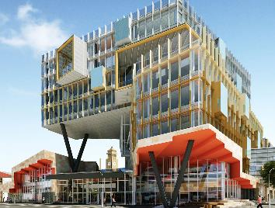

Engineering Disciplines
Civil
Water
Structural
Electrical
Notes:
There are a large number of engineering disciplines, each with its own unique specialisations. However, all engineering disciplines share the common principle of solving a problem and making something work. Whether it be working out how to support a 50 storey building or calculating how much water storage is required to allow a hydro dam to meet energy demands, engineers are problem solvers. Engineers have developed methods, formulas and standards to ensure that problems are solved in a safe, economical and efficient manner.
It is likely you have heard of most of these common engineering disciplines before. Civil, Structural and Water Engineering all come under the Civil degree that many local engineers have studied along with Geotechnical engineering which I haven’t included in these slides. Electrical………………………….

Slide 10




Engineering Disciplines
Mechanical
Biomedical
Chemical
Software
Notes:
Mechanical

Slide 11
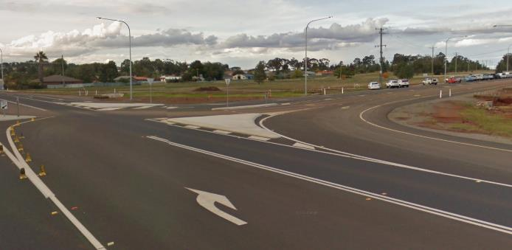
Civil Engineering
“An engineer who designs and maintains roads, bridges, dams and similar structures”
Civil engineers are involved in a wide variety of projects and have a great deal of input into public infrastructure such as roads, water supply, bridges etc.
Parkes Bypass Rd

Slide 12
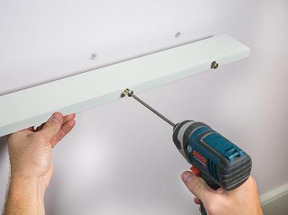
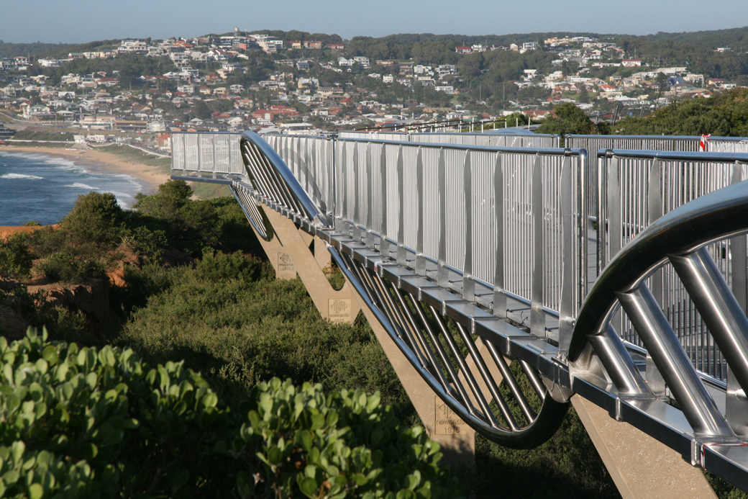
Structural Engineering
“A specialty within Civil Engineering that primarily focuses on the design and construction of structures”
A structural engineer gets the challenging yet rewarding task of ensuring the built environment remains standing. Whether it be a multistorey tower or a single bolt.

Slide 13
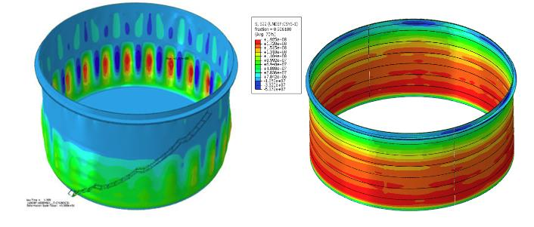
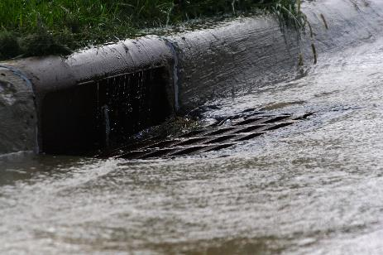
Water Engineering
“A specialty within Civil Engineering that primarily focuses on the design and construction of structures that control water resources”
Includes the design of water mains, dams and reservoirs.
Notes:
Please replace the text only for your body slides – do not delete the background image with the EA logo.

Slide 14


Electrical Engineering
“Deals with the technology of electricity, especially the design and application of circuitry and equipment for power generation and distribution, machine control and communications”
Includes the design of power lines, building circuitry and have vast input into solar power generation.
Notes:
Please replace the text only for your body slides – do not delete the background image with the EA logo.

Slide 15
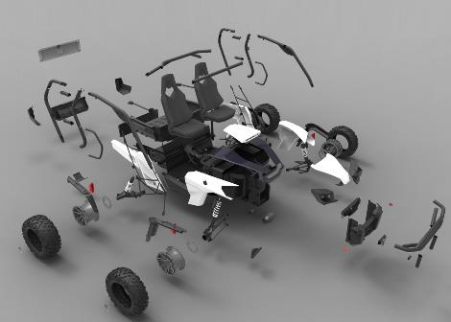
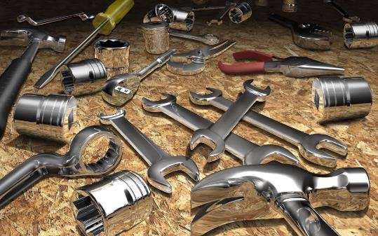
Mechanical Engineering
“The branch of engineering dealing with the design, construction, and use of machines”
Includes the engineering of tools, cogs, moving components and machines.
Notes:
Please replace the text only for your body slides – do not delete the background image with the EA logo.

Slide 16
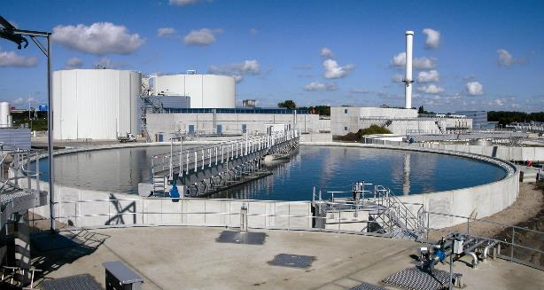

Chemical Engineering
“Deals with the technology of chemical production and the manufacturing of products through chemical processes”
Includes the design and development of new materials and the design of treatment facilities.
Notes:
Please replace the text only for your body slides – do not delete the background image with the EA logo.

Slide 17
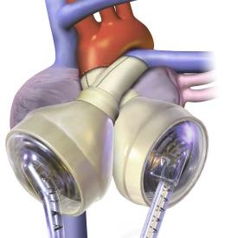

Biomedical Engineering
“Deals with the integration of engineering sciences with biomedical sciences and clinical practice”
Includes the design of prosthetics, diagnostic devices and artificial organs.
Notes:
Please replace the text only for your body slides – do not delete the background image with the EA logo.

Slide 18


Software Engineering
“Deals with the approach to development, operation and maintenance of software”
Includes the design of games, programs, websites etc.
Notes:
Please replace the text only for your body slides – do not delete the background image with the EA logo.

Slide 19
Engineering Materials
Materials are fundamental building blocks of engineering.
Students of engineering learn about repeatable and reproducible engineering properties that can be applied to solve engineering problems.
Materials is taught in the second year of an engineering diploma or degree and it is important that those moving into engineering get a solid understanding of this area.
The success of any engineering project is only as good as the materials from which they are made and the workmanship to do so
Notes:
Materials are fundamental building blocks of engineering.
Students of engineering learn about repeatable and reproducible engineering properties that can be applied to solve engineering problems.
Materials is taught in the second year of an engineering diploma or degree and it is important that those moving into engineering get a solid understanding of this area.
The success of any engineering project is only as good as the materials from which they are made and the workmanship to do so

Slide 20
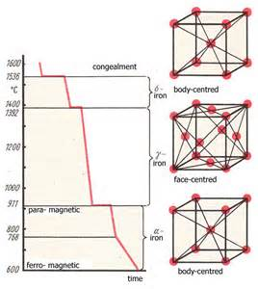
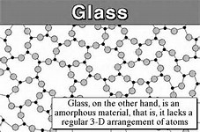
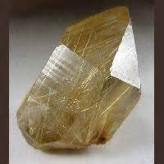
Engineering Materials
P2.1 describes the types of materials, components and processes and explains their implications for engineering development
Classification of materials by properties: weight, density, strength, stiffness
Amorphous (Glass)
Crystalline
(Sand Aggregates)
Lattice (Metals)

Slide 21
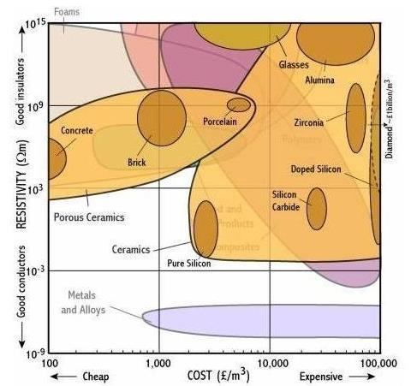
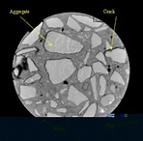
Engineering Materials
P2.1 describes the types of materials, components and processes and explains their implications for engineering development
Ceramics
(Industrial applications)
Composite (Concrete)

Slide 22
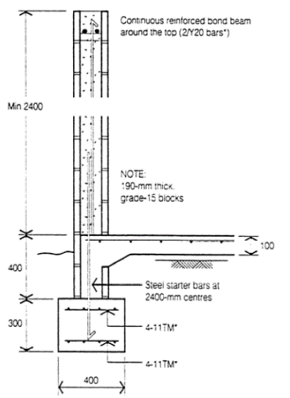
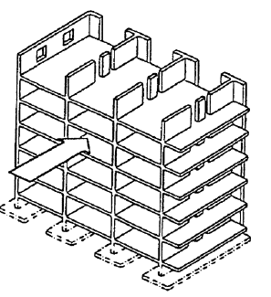

Engineering Materials – Ceramics & Masonry
P2.1 describes the types of materials, components and processes and explains their implications for engineering development
Load bearing masonry structure
Newcastle Cathedral
Notes:
Masonry has significant structural applications because of its high compressive strength for load bearing
Low Bond strength which can affect lateral strength in wind and earthquake
Clay bricks are made by firing a mixture of clay and shale in a kiln at high temperature (c1000deg cel)
Concrete bricks are manufactured using a press, vibration or a combination to compact moderate-strength concrete into moulds. The blocks are usually steam or burner cured
Modern load bearing masonry with floors and shear walls to resist lateral loads

Slide 23
Engineering Materials – Ceramics & Masonry
P2.1 describes the types of materials, components and processes and explains their implications for engineering development
Mortar Weakened Wall
Salt Attack in Clay Bricks
Notes:
Masonry bricks and mortar are exposed to chlorides from salt spray that can create vulnerable to salt attack

Slide 24
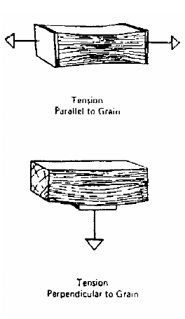
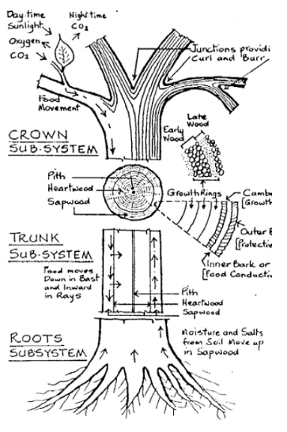
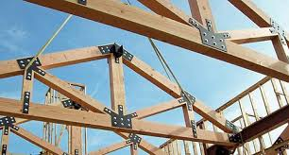
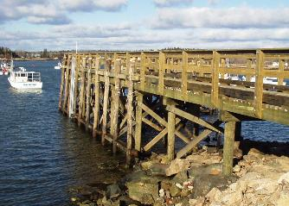

Engineering Materials - Timber
P2.1 describes the types of materials, components and processes and explains their implications for engineering development
Tensile Stress in Timber
Notes:
The tensile strength of timber is significantly lower than its bending strength.
Perpendicular to the grain the tensile strength is very low and design should avoid stresses in this direction
Structural Properties
High flexural strength and stiffness relative to weight in the longitudinal direction
Good Shear Strength
Selection Process
- Generally economical
- Easily constructed using skills generally available
- High stiffness and strength to weight ratio
- Good thermal and electrical properties
- Resistance to certain forms of chemical attack

Slide 25
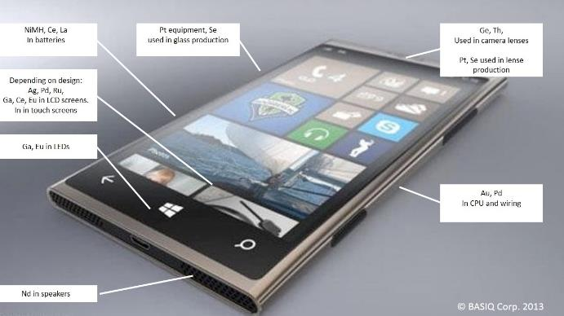

Engineering Materials - Metals
P4.1 describes developments in technology and their impact on engineering products
P4.2 describes the influence of technological change on engineering and its effect on people
2016 – Apple reclaimed 1,000kg in gold or approx. $48 Million (Australian)
Quenching and tempering plus alloys produce armour
Notes:
Strength increase with carbon content at the expense of toughness and welding ability.
Mild Steel 0.1%
Structural 0.15 to 0.2%
Reinforcing 0.2 to 0.3%
Prestressed 0.8%
Ferrous Metals
Cast iron and Steels
Non Ferrous Metals
Aluminum, copper, magnesium, nickel, titanium, zinc, lead, tin, refractory, precious
Super Alloys
Iron-based, nickel-based, cobalt-based
A list of Rare Earth Elements:
Ce – Cerium
Dy – Dysprosium
Er – Erbium
Eu – Europium
Gd – Gadolinium
Ho – Holmium
La – Lanthanum
Lu – Lutetium
Nd – Neodymium
Pr – Praseodymium
Pm – Promethium
Sm – Samarium
Sc – Scandium
Tb – Terbium
Tm – Thulium
Yb – Ytterbium
Y – Yttrium

Slide 26
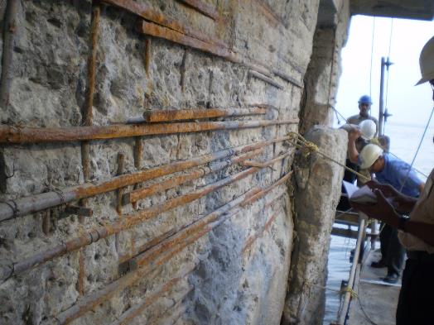

Engineering Materials - Concrete
Lloyd Wright
Waterfall House
Concrete Cancer
Notes:
Primitive concrete dates back to
6500 BC in Syria
5600 BC in Danube River
3000 BC in North West China
Inorganic cements
2500 BC in Egypt with gypsum Binder
2000 BC, lime, Crete and Egypt
Earliest is a wall in Thebes (Egypt)~ artisans fill earthenware jars with water, which is then mixed with lime to create mortar = masonry-faced concrete wall.
Lime Pozzolan Concrete
Romans~ 75 BC
Lime and volcanic ash, containing silica and alumina
Strength comparable to modern
Roman’s = 18th century knowledge
Often covered by masonry
English Concrete
All concrete for next 1300 years used lime mortars, set by hydrating and gain limited extra strength from carbonation.
Minor amounts of Saxton Concrete from 70 AD
Normans more sophisticated in 1066. (Castles, towers etc…)
Modern Development
Hydraulic Cement~ John Smeaton 1756, combined Lime and Italian Pozzolan to produce cement that sets under water. 1st high quality since fall of Rome.
Portland Cement
Joseph Asphin, Fired Lime and clay together, October 1824.
Found high temp most effective
Name comes from colour of stone from Portland
Reinforcement
William Wilkinson, 1854, iron strips and ropes
Monier, France, 1867.
Freycinet, prestressing, 1928

Slide 27
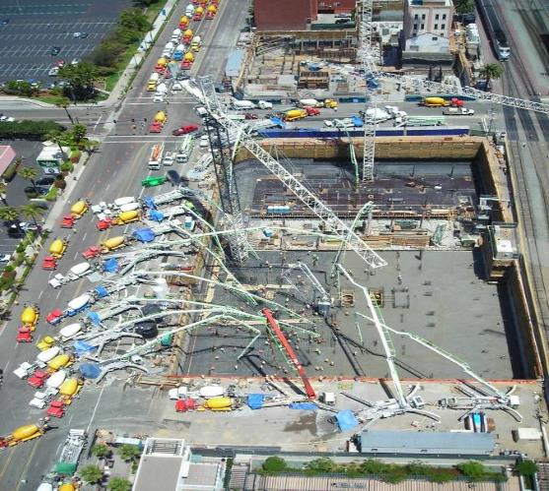
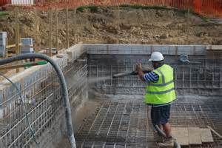
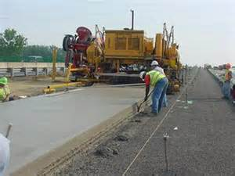
Engineering Materials - Concrete Forming
P2.1 describes the types of materials, components and processes and explains their implications for engineering development
P4.1 describes developments in technology and their impact on engineering products
Sprayed Concrete
Slip-formed Concrete
Hand-Placed Concrete

Slide 28
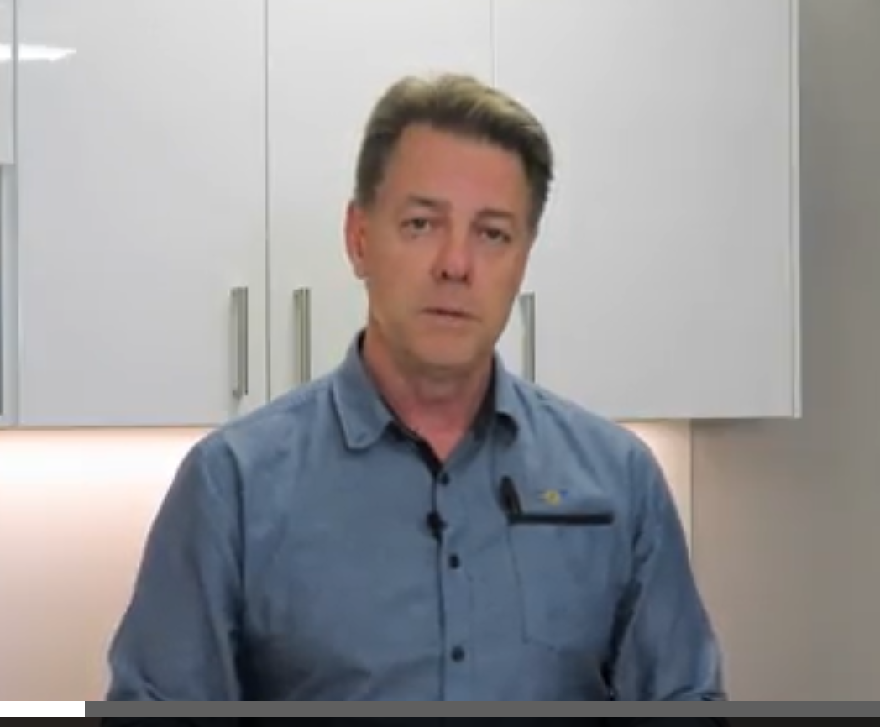
Engineering Granular Materials
Roadbases Videos on Compaction
Michael van Koeverden
Compaction in the classroom
The role of confining pressure
Source: CCAA
Road Compaction in layers
Notes:
Primitive concrete dates back to
6500 BC in Syria
5600 BC in Danube River
3000 BC in North West China
Inorganic cements
2500 BC in Egypt with gypsum Binder
2000 BC, lime, Crete and Egypt
Earliest is a wall in Thebes (Egypt)~ artisans fill earthenware jars with water, which is then mixed with lime to create mortar = masonry-faced concrete wall.
Lime Pozzolan Concrete
Romans~ 75 BC
Lime and volcanic ash, containing silica and alumina
Strength comparable to modern
Roman’s = 18th century knowledge
Often covered by masonry
English Concrete
All concrete for next 1300 years used lime mortars, set by hydrating and gain limited extra strength from carbonation.
Minor amounts of Saxton Concrete from 70 AD
Normans more sophisticated in 1066. (Castles, towers etc…)
Modern Development
Hydraulic Cement~ John Smeaton 1756, combined Lime and Italian Pozzolan to produce cement that sets under water. 1st high quality since fall of Rome.
Portland Cement
Joseph Asphin, Fired Lime and clay together, October 1824.
Found high temp most effective
Name comes from colour of stone from Portland
Reinforcement
William Wilkinson, 1854, iron strips and ropes
Monier, France, 1867.
Freycinet, prestressing, 1928

Slide 29
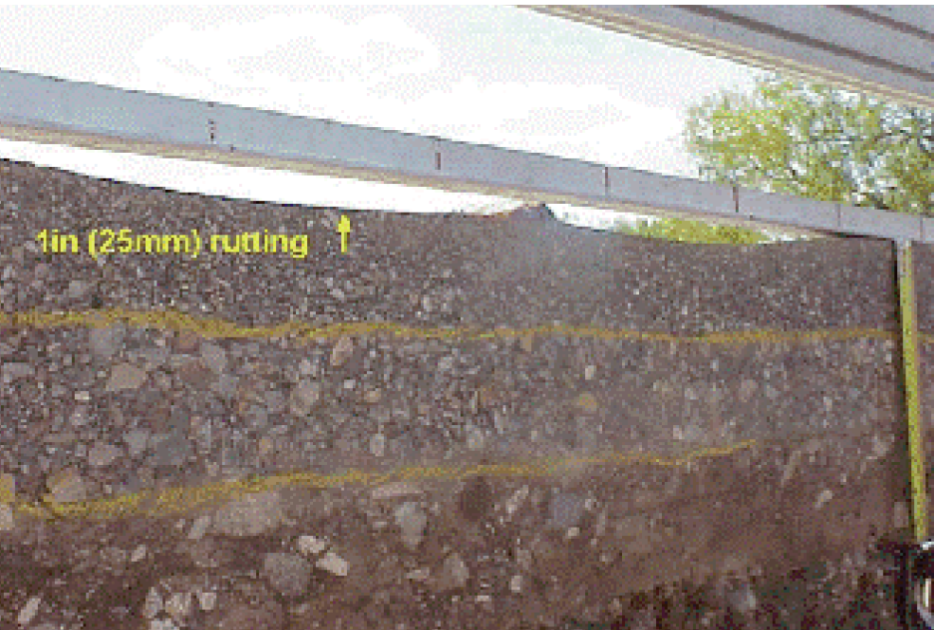
Engineering Granular Materials
Roadbases Videos on Compaction
https://www.youtube.com/watch?v=qq09VuGYE1E
https://www.youtube.com/watch?v=nQsgbnTxZXs
https://www.youtube.com/watch?v=Q69a_LiqC3s
Source: CCAA
Road pavement layers
Notes:
Primitive concrete dates back to
6500 BC in Syria
5600 BC in Danube River
3000 BC in North West China
Inorganic cements
2500 BC in Egypt with gypsum Binder
2000 BC, lime, Crete and Egypt
Earliest is a wall in Thebes (Egypt)~ artisans fill earthenware jars with water, which is then mixed with lime to create mortar = masonry-faced concrete wall.
Lime Pozzolan Concrete
Romans~ 75 BC
Lime and volcanic ash, containing silica and alumina
Strength comparable to modern
Roman’s = 18th century knowledge
Often covered by masonry
English Concrete
All concrete for next 1300 years used lime mortars, set by hydrating and gain limited extra strength from carbonation.
Minor amounts of Saxton Concrete from 70 AD
Normans more sophisticated in 1066. (Castles, towers etc…)
Modern Development
Hydraulic Cement~ John Smeaton 1756, combined Lime and Italian Pozzolan to produce cement that sets under water. 1st high quality since fall of Rome.
Portland Cement
Joseph Asphin, Fired Lime and clay together, October 1824.
Found high temp most effective
Name comes from colour of stone from Portland
Reinforcement
William Wilkinson, 1854, iron strips and ropes
Monier, France, 1867.
Freycinet, prestressing, 1928

Slide 30
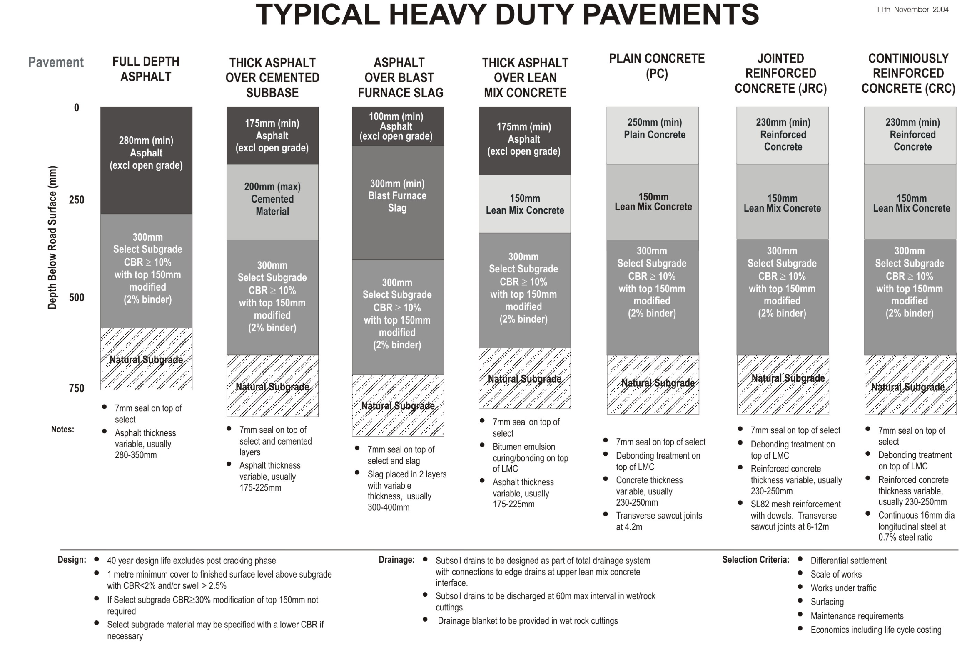
Engineering Granular Materials
Roadbases and their use
Source: CCAA
Notes:
Primitive concrete dates back to
6500 BC in Syria
5600 BC in Danube River
3000 BC in North West China
Inorganic cements
2500 BC in Egypt with gypsum Binder
2000 BC, lime, Crete and Egypt
Earliest is a wall in Thebes (Egypt)~ artisans fill earthenware jars with water, which is then mixed with lime to create mortar = masonry-faced concrete wall.
Lime Pozzolan Concrete
Romans~ 75 BC
Lime and volcanic ash, containing silica and alumina
Strength comparable to modern
Roman’s = 18th century knowledge
Often covered by masonry
English Concrete
All concrete for next 1300 years used lime mortars, set by hydrating and gain limited extra strength from carbonation.
Minor amounts of Saxton Concrete from 70 AD
Normans more sophisticated in 1066. (Castles, towers etc…)
Modern Development
Hydraulic Cement~ John Smeaton 1756, combined Lime and Italian Pozzolan to produce cement that sets under water. 1st high quality since fall of Rome.
Portland Cement
Joseph Asphin, Fired Lime and clay together, October 1824.
Found high temp most effective
Name comes from colour of stone from Portland
Reinforcement
William Wilkinson, 1854, iron strips and ropes
Monier, France, 1867.
Freycinet, prestressing, 1928

Slide 31
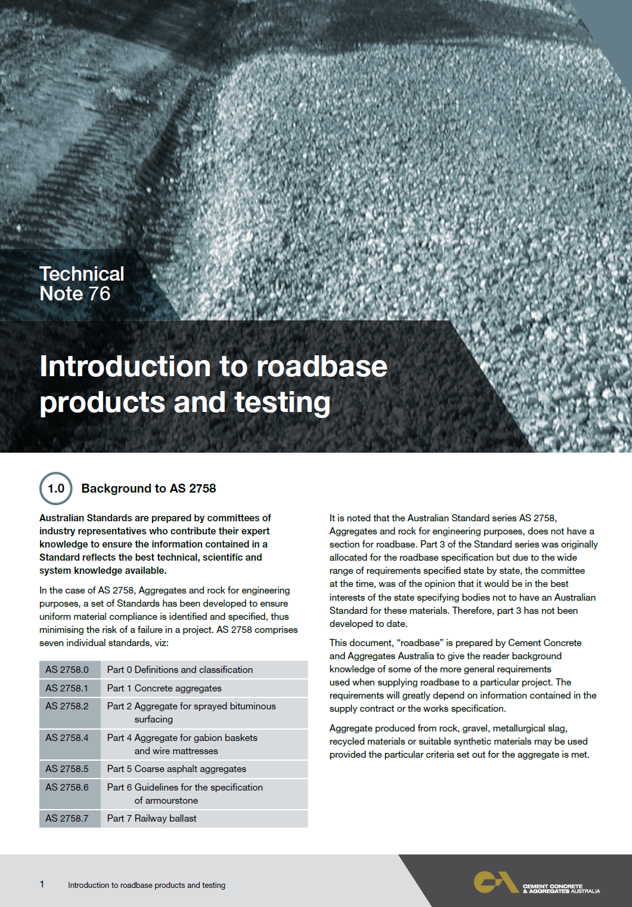
Engineering Granular Materials
Roadbases and their use
https://www.ccaa.com.au/iMIS_Prod/CCAA/Public_Content/PUBLICATIONS/Technical_Publications/Notes/Technical_Note_76_-_Introduction_To_Roadbase_Products_And_Testing.aspx?WebsiteKey=4998d6ce-2791-4962-b1e2-6b717f54a8d3
Source: CCAA
Road pavement layers
Notes:
Primitive concrete dates back to
6500 BC in Syria
5600 BC in Danube River
3000 BC in North West China
Inorganic cements
2500 BC in Egypt with gypsum Binder
2000 BC, lime, Crete and Egypt
Earliest is a wall in Thebes (Egypt)~ artisans fill earthenware jars with water, which is then mixed with lime to create mortar = masonry-faced concrete wall.
Lime Pozzolan Concrete
Romans~ 75 BC
Lime and volcanic ash, containing silica and alumina
Strength comparable to modern
Roman’s = 18th century knowledge
Often covered by masonry
English Concrete
All concrete for next 1300 years used lime mortars, set by hydrating and gain limited extra strength from carbonation.
Minor amounts of Saxton Concrete from 70 AD
Normans more sophisticated in 1066. (Castles, towers etc…)
Modern Development
Hydraulic Cement~ John Smeaton 1756, combined Lime and Italian Pozzolan to produce cement that sets under water. 1st high quality since fall of Rome.
Portland Cement
Joseph Asphin, Fired Lime and clay together, October 1824.
Found high temp most effective
Name comes from colour of stone from Portland
Reinforcement
William Wilkinson, 1854, iron strips and ropes
Monier, France, 1867.
Freycinet, prestressing, 1928

Slide 32
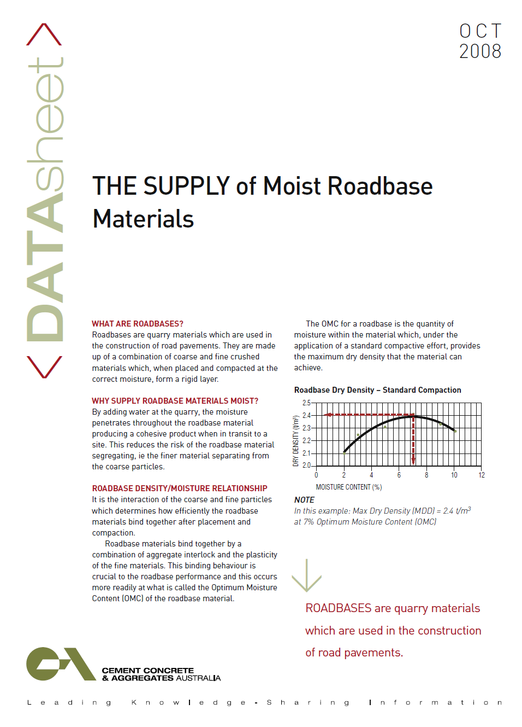
Engineering Granular Materials
Roadbases and their use
https://www.ccaa.com.au/iMIS_Prod/CCAA/Public_Content/PUBLICATIONS/Technical_Publications/Datasheets/The_supply_of_Moist_Roadbase_Materials.aspx?WebsiteKey=4998d6ce-2791-4962-b1e2-6b717f54a8d3
Source: CCAA
Moisture in Road pavement layers
Notes:
Primitive concrete dates back to
6500 BC in Syria
5600 BC in Danube River
3000 BC in North West China
Inorganic cements
2500 BC in Egypt with gypsum Binder
2000 BC, lime, Crete and Egypt
Earliest is a wall in Thebes (Egypt)~ artisans fill earthenware jars with water, which is then mixed with lime to create mortar = masonry-faced concrete wall.
Lime Pozzolan Concrete
Romans~ 75 BC
Lime and volcanic ash, containing silica and alumina
Strength comparable to modern
Roman’s = 18th century knowledge
Often covered by masonry
English Concrete
All concrete for next 1300 years used lime mortars, set by hydrating and gain limited extra strength from carbonation.
Minor amounts of Saxton Concrete from 70 AD
Normans more sophisticated in 1066. (Castles, towers etc…)
Modern Development
Hydraulic Cement~ John Smeaton 1756, combined Lime and Italian Pozzolan to produce cement that sets under water. 1st high quality since fall of Rome.
Portland Cement
Joseph Asphin, Fired Lime and clay together, October 1824.
Found high temp most effective
Name comes from colour of stone from Portland
Reinforcement
William Wilkinson, 1854, iron strips and ropes
Monier, France, 1867.
Freycinet, prestressing, 1928

Slide 33
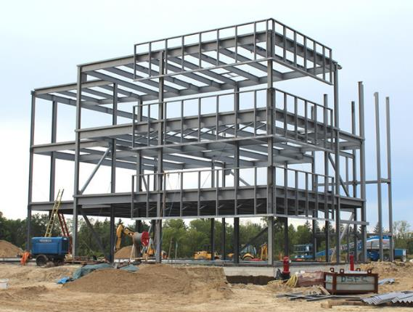
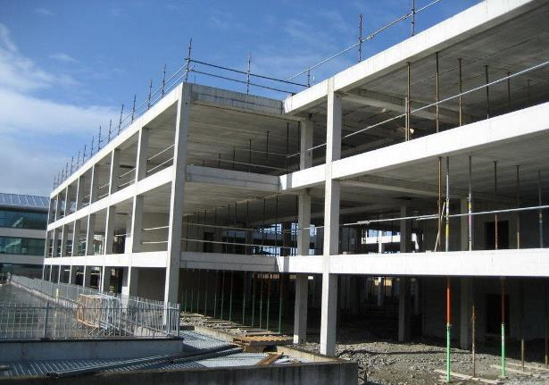
Engineering Materials - Concrete or Steel
P1.2 explains the relationship between properties, structure, uses and applications of materials in engineering
P4.2 describes the influence of technological change on engineering and its effect on people
When should reinforced concreted be used?
Notes:
Reinforced Concrete and Structural Steel are two of the main construction materials used in modern structural design. The choice between the two often comes down to the designers personal preference however there are a number of factors to take into consideration before making a choice. Reinforced Concrete is now far more economically viable than it was in the past and is even becoming competitive in high rise construction, an area that was previously dominated by structural steel around the world. Australia has always been a strong proponent of concrete, opting to use it on larger buildings far more often than other countries.
One factor that often leads to the choice of Structural Steel over Reinforced Concrete is the foundation conditions. Often sites with poor foundation conditions will use structural steel to minimise the weight of the structure. Steel is also prefabricated and thus requires less workers on site than concrete and also provides faster construction times.
Alternatively, Reinforced Concrete is often chosen due its superior fire performance in comparison to Structural Steel. It can also provide a much slimmer profile than steel members as the beams are built into the floor slab. This can increase usable floor heights in buildings.
One of the main negatives for using reinforced concrete is the cost of formwork. Formwork can make up a significant proportion of the total construction cost and thus must be considered when making the initial decision between materials.

Slide 34
Engineering Materials – Renewable Materials
P4.2 describes the influence of technological change on engineering and its effect on people
P4.3 identifies the social, environmental and cultural implications of technological change in engineering.
Carbon footprint -specific mats may be high to make (E.g. Cement)
Process improvements to reduce carbon ( E.g. Limestone / Cement)
Use of low carbon materials in construction
Incentives to reduce carbon- (Green star buildings etc).
Recycled materials may not have suitable properties vs. virgin mats
Cost of recycling may be more harmful to environment than virgin mats
Environmental, social , economic risk to society of mats use or not?
Waste management from production processes
Notes:
Lighter stronger materials
More sustainable materials and processes
Life cycle of material- whole of life analysis (material-birth to grave)
Nano-engineered materials- (smaller with customised applications)
Material optimisation of existing and new products / processes

Slide 35
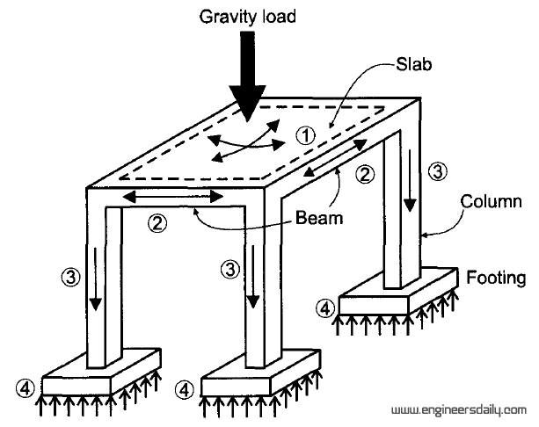
Load Paths
P3.1 uses mathematical, scientific and graphical methods to solve problems of engineering practice
It is important to understand where a load must go when looking at a structure. Where does it start, where will it end up and how does it get there?
Slab
Beam
Column
Footing
Follow the load
Notes:
Any load that goes into a structure must be able to make it to a support. This means checking the capacity of that support and any member or connection the force must pass through to get to that point.

Slide 36
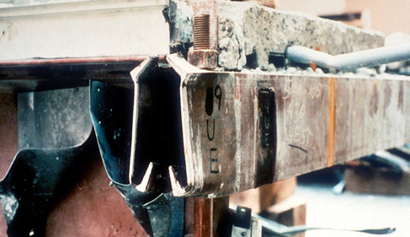
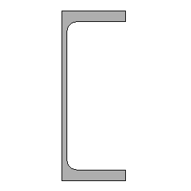
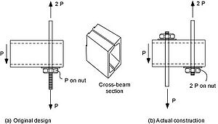
Case Study – Hyatt Regency, Kansas City
in 1981, Walkway collapse due to a simple detail change that wasn’t given appropriate consideration. (114 fatalities, 200 injured)

Slide 37

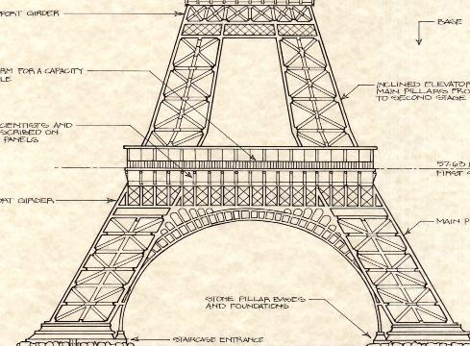

Case Study – Eiffel Tower
Which person is easier to push over ?

Slide 38


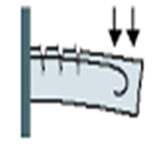
Case Study – simple support and cantilever
Simply supported beam
Cantilevered beam
Tension in bottom
(steel in bottom)
Tension in top
(steel in top)
“Steel is great in tension
Concrete is great in compression”
Notes:
Back story: Aaron was asked to undertake inspections of balconies on a building in Darling Point. The purpose was to determine the position of the reinforcement in the slabs as large deflections had been observed. Some of the balconies were found to have the reinforcement in the bottom 20mm of concrete on a 150mm slab. No balconies had failed but some had deflected to the point that it was noticeable to the naked eye. The suspected reason for the reinforcement placement is just poor construction. The building is over 60 years old and was constructed by a group of farmers. It is suspected that the reinforcement was laid with nothing holding it in place and it has sunk after the concrete was poured. This would explain the erratic reinforcement positions. The proposed solution was to support the balconies from the roof as support columns were not an option to impedance of driveways.

Slide 39




Case Study – Principles of mechanics of solids
Which is the best orientation and use of material?

Slide 40




Slide 41


Slide 42


Slide 43



Classroom Exercises

Slide 44


Beam properties - materials

Slide 45
Summary
Engineers Australia is your link with the Engineering Profession / Industry
These Presentations and forums can provide important networking opportunities with other teaching professionals
Engineers Australia can assist in providing exciting ways of presenting concepts with real world examples and applications.
We encourage a link of support with exam assessors
We emphasise that pathways to engineering exist for all students- Professional, Technical, Trade, VET

Slide 46

Pathways to Engineering

