Slide 1
FIRE UPGRADES OF EXISTING BUILDINGS
Voluntary and forced upgrades if existing buildings – interaction between regulatory authorities and the mechanisms of approval.
Dean Morton – Technical Inner Sight Pty Ltd

Slide 2
Voluntary upgrades
Building owner initiates upgrades due to:
Duty of care to occupants
Risk analysis on larger commercial buildings
Risk reduction for potential loss of productivity post fire event
Insurance implications
Past occurrences of interactions with Council or other Authorities

Slide 3
Forced upgrades
Initiated by Council or FRNSW
Usually based from complaint passed onto the Authority (reactive)
Fire safety order (section 121B of the EP&A Act, order #6)
Where under an order can be prosecuted if not complied with
Order terms can often be negotiated
Not subject to a development consent or construction certificate
Council may exercise discretion as to the extent of upgrade

Slide 4
Mechanisms of acceptance - Voluntary
Can often be undertaken as complying development (CDC)
Where it is a CDC no Council involvement (preferable?)
CDC does not require FRNSW referral at the assessment stage (may require request for final inspection if affecting class 2 or 3 buildings where impacting “relevant fire safety system”)
Must be prepared as a fire engineering report
The CDC approves the physical building works only, eg a CDC can not be issued to adopt a FER that justifies levels of safety to a built form or use.
Will most likely involve a BCA consultant and an accredited certifier (conflict of interest) and fire engineer. Need for consistency in approach between each.
Not possible to heritage listed buildings
Can approach Council for issue of an order

Slide 5
Forced upgrades – Order #6
Issued by Council – principally to relate to “To do or refrain from doing such things as are specified in the order so as to ensure or promote adequate fire safety or fire safety awareness”
Can be used to adopt fire safety strategies, eg report based on probabilistic analysis where no physical works required
Includes notice period where the terms of the order may be discussed
Often notice issued with no works required and imposes to the recipient to provide a report identifying recommended upgrades
Competency of the Council fire safety officers – variable
Council has the ability to exercise discretion, order #6 does not refer to the BCA in any way.
Issue of order does not need separate DA/CC/OC
Orders issued with time period for compliance
Enforced through the court, can result in further order #10 to vacate the premises

Slide 6
Working together? An integrated approach
When undertaken as a CDC the certifier becomes the authority having jurisdiction
Council involvement – difficulty with varying degree of staff experience across Council areas often slows process or creates higher levels of conservatism
Convincing Council they are able to use discretion when utilising fire orders
Fire orders remove planning controls and permit works to commence immediately (benefit to client and occupants)
Often no holistic BCA assessment report, scope usually figured out on site and therefore needs fire engineer to be “hands on”
When does FRNSW get involved?
Council request based of type of building (level of risk)
When impacting fire safety systems (hydrants)
If complaint originated to FRNSW

Slide 7
Case study (ongoing) – hotel accommodation
Three storey hotel (partial basement level). Class 6 ground floor, class 3 first floor. Type A construction
Principal issue being extended travel distances to single non fire isolated exit up to 20m
Heritage listed building
Council commenced upgrade. No order issued, no direction given as to what needs to be upgraded
Site inspection undertaken between client, BCA consultant, fire engineer to identify risks and opportunities to resolve
Short form upgrade strategy prepared to get Council on board (limit costs to client until authority gave in principal support)
Required multiple meetings with several officers before the short form strategy was agreed (verbally only)

Slide 8
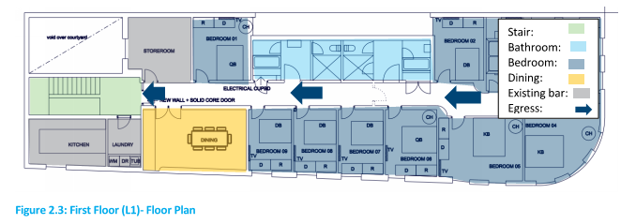
Accommodation level:

Slide 9
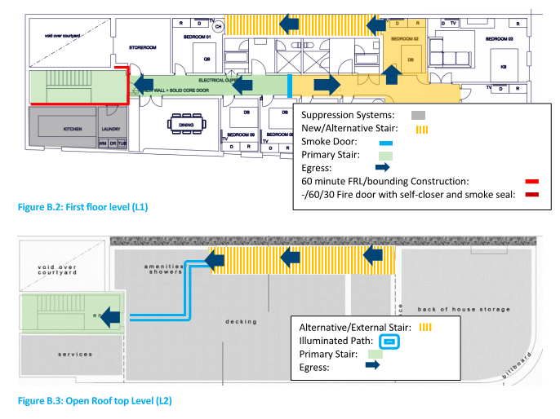
Upgrade strategy

Slide 10
Challenges and benefits of approach
Challenges:
Dealing with multiple Council officers. Needing to get to senior staff in decision making positions time consuming and required client intervention.
Aligning the clients expectations to that of the consultant team
Fire safety officer undertook the internal discussions with heritage section
Benefits:
Heritage building – enabled the works to be undertaken without needing a DA/CC.
Gave flexibility as to when works could be undertaken
Enabled to use of non compliant stair without needing to separately address that as a non compliance
Suitable level of life safety being obtained
Cost – fire order is free from Council

Slide 11
Case Study (ongoing) – apartment building
Existing four storey apartment building
Upgrade as a result of compliance audit initiated by the Body Corporate
To be undertaken as complying development
Compliance matters principally relate to exit configurations and fire hydrant design
Scope of non compliances resolved between the BCA consultant and fire engineer prior to certifier involvement
Conflict of interest provisions preclude the certifier directing the approach to be taken, role is to certify the proposed works only.

Slide 12
Challenges and benefits of approach
Challenges:
Ensuring that roles of the parties are understood. Client believes certifier takes over BCA consultants role
Works must fit within controls of complying development, may require alternate approaches that are not preferred
Fire hydrant works require request for FRNSW inspection at completion
Benefits:
Single decision maker
Certification process is more familiar to parties (BC like getting OC’s)
Time – CDC can be issued in a day

Slide 13
Thank you
Questions?

