Slide 1
Child Evacuation Performance
IN MULTISTOREY BUILDINGS
NCC Performance Review into how to best assess Data Sets in High Rise Child Evacuation Scenarios
Presented by Stephen Burton CPEng, NER
Ferm Engineering - Managing Director
Society of Fire Safety Qld Chairman

Slide 2
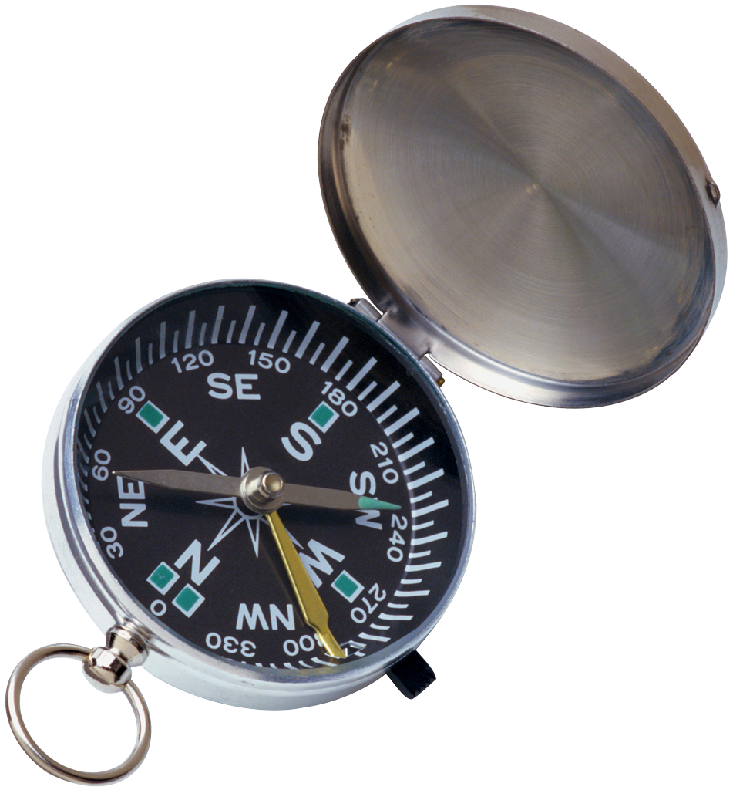
ABOUT THIS SEMINAR
Making a new direction. Does the BCA deal with Child Care in High Rise (DtS vs Performance)
State legislation requirements under the Department of Education (State and Federal)
How the NCC assesses the safe evacuation of children - or not
What design tools to use to facilitate your design for evacuation of children
Concept design, policies, education and procedures to be considered
Education in Fire safety

Slide 3
1 WHY WE ARE HAVING THIS DISCUSSION
The BCA was developed back in the 1980’s (FCRC) but had no studies on child evacuation in buildings over 2 or 3 storeys. So its time to update.
BCA had not foreseen this use at the time, but times have changed.
Qld has 2889, NSW has 5396, SA has 1168, Vic has 4164, WA has 1175, Tas has 235, NT has 222, ACT has 352 registered Child Care and Education facility providers. That’s 15,601 facilities and now growing into high rise facilities. They cater for nearly 1 million children.
International Building Codes (UK, US, ERU) have conditions for Children in the evacuation process. E.G. NFPA 101 child day care is simply Not Permitted in buildings over 4 levels unless sprinklered and provided with NFPA 101 class I, II fire rated construction methods.
The NCC has no DtS measures to safely allow children to evacuate from a high rise building by comparative International Standards. DtS is considered for ambulant adults, not infants.
Child Day Care and Aged Care in high rise is a recent development, so we need to adapt
City Plans do not factor in the real risks involved (i.e. Brisbane City Plan has 400% error)

Slide 4
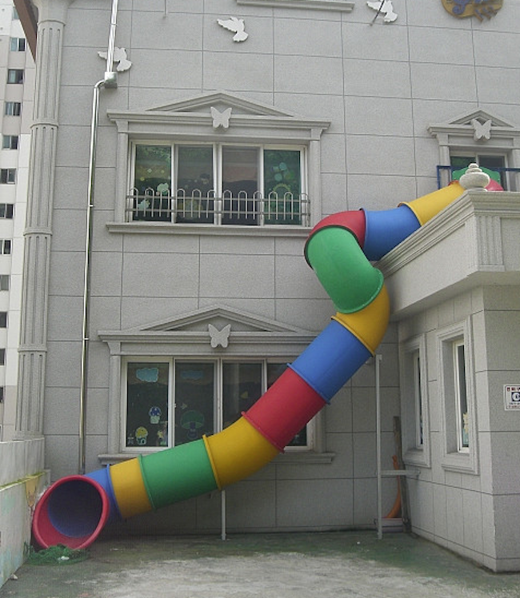
THE SITUATION - KEEP IT REAL
There is a world wide change to child care and solutions are not conventional by Australian Standards

Slide 5

2 State legislation for child care

Slide 6
LEGISLATION - WHO’S IN CHARGE OF FIRE SAFETY
The federal government introduced a National Code for Child Care and Education - ACECQ
To operate facility owners need an approval from state authorities, but mainly the chief executive administering the “Education and Care Services National Law Act 2010”
An objective of these Acts is to ensure the safety, health and wellbeing of children - so in assessing applications, this is a requirement! ACECQ do not administer this process.
But, the childcare National Law has weakened protections for children in multi-storey buildings, transferring reliance to Building Law and Regulation by the states and territories
EG..Queensland withdrew the Child Care Act and QDC legislation (QDC MP5.4), but nothing was added to the National Act or NCC 2016 fire safety sections to compensate. States adopted the new National Laws with the issue of fire safety unchecked and unresolved.
Premises applications are relying on a 25+ year old building code (NCC) and unreliable building certification processes in each state to address fire evacuation measures - so is that appropriate for high rise child care assessments? NO IT IS NOT

Slide 7
LEGISLATION - WHO’S IN CHARGE OF FIRE SAFETY
All Child Care applications go to the Department of Education in each state to verify compliance
The work practices and placements are contained in government guidelines for Children’s Services regulated at State and Territory levels.
The aspect of Fire safety in the premises, procedures and performance is not assessed by them. It is a loose referral to the building approval process only.
Plans and details must be submitted and other approvals also gained from the State Planning and Building authorities. Assessment Criteria for development In a Centre Zone (city e.g. PC1, PC2). This is where new Child Care locations will be added and have been added, in multi-storey buildings
Planning instruments for placement of a childcare centre within the community in the past made centres only acceptable if on ground or no higher than 2 levels
So this means the Building Certifier is in charge of child fire safety and the approval of this aspect. No other referrals are occurring beyond this currently.
Education for Fire Safety in not part of the curriculum in Australian Schools or our Educators

Slide 8
3 The BCA AND CHILD CARE IN HIGH RISE BUILDINGS
What the does the NCC contain to facilitate the design of Child Care for High Rise?
The BCA is based on the Fire Code Reform Centre studies 1980’s research and past legislation. That’s now more than 30 years ago.
NCC Volume 1 Class 9b – defines Early Childhood Centre or School as .. … . ..
Assembly building means a building where people may assemble for:
educational purposes in a school, early childhood centre, preschool, or the like;
Early childhood centre means any premises or part thereof providing or intending to provide a centre-based education and care service within the meaning of the Education and Care Services National Law Act 2010 (Vic), the Education and Care Services National Regulations and centre-based services that are licensed or approved under State and Territory children's services law, but excludes education and care primarily provided to school aged children in outside school hours settings.

Slide 9
The BCA AND CHILD CARE IN HIGH RISE BUILDINGS
There are separate NCC sections for Tasmania, Victoria and NSW
E.G… NSW (Part), Early childhood centre means: a preschool, kindergarten or child-minding centre for the care or training of more than 5 children.
The NCC in Section A0.2 states:
Meeting the Performance Requirements: The Performance Requirements can only be satisfied by a—
(a) Performance Solution; or
(b) Deemed-to-Satisfy Solution; or
(c) combination of (a) and (b).
Assessment Method means a method used for determining that a Building Solution complies with the Performance Requirements.
These are the set of application rules we follow in the Child Care Assessments in this review.
Following the DtS assessment of Sections A, C, D – we compare these to reality

Slide 10
BCA SECTION A – NCC VOLUME 1
A0.1 Compliance with the NCC is achieved by satisfying the Performance Requirements. That is First and Foremost. But noting it can be a combined DtS and Performance design.
Assessment in Class 9b — “an assembly building, including a trade workshop, laboratory or the like in a primary or secondary school, but excluding any other parts of the building that are of another Class”
Does not sound like a Child Care definition and worse if relating to high rise applications
I will introduce comparisons to Class 3 or 9c: Aged Care for reasons of similar evacuation needs. Both have element that could be applied to child care or accommodation.
I suggest using Class 9b is not acceptable and earmarked for change in the NCC 2019
So what is needed to meet A0.1 if DtS is used as a Class 9b in high rise, over 3 levels. What’s involved? Does NCC 2016 satisfy performance for child evacuations?
Seek Other Resources EG. National Resource Center for Health and Safety in Child Care and Early Education- USA based organisation NRC, or NFPA, UK The Fire Safety Advice Centre.

Slide 11
BCA SECTION C – NCC VOLUME 1
Class 9b – Relevant Section C parts
C1.10 Fire hazard properties :(a) The fire hazard properties of the following linings, materials and assemblies in a Class 2 to 9 building must comply with Specification C1.10
These are lower for Class 9b than Class 3, 9a
Wall and Ceiling inning materials are group 1 or 2 (unsprinklered)
Compartment Sizes C2.2 is Type A = 8000m² - that’s a large floor
Type A separation requirements and construction of fire isolated exits and Floors, Fire Walls in Spec C1.1 = FRL 120/120/120
Up to 25m (9 levels) - no sprinklers, over 25m provision for Sprinklers

Slide 12
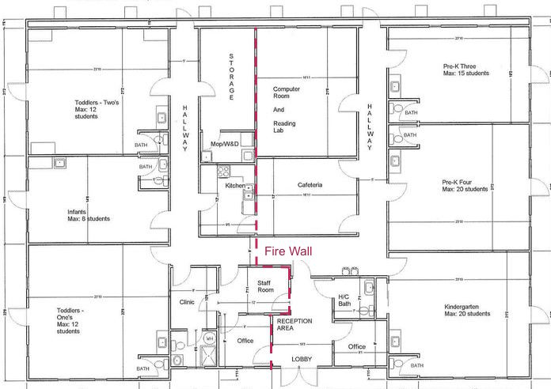
BCA SECTION C – NCC VOLUME 1
Class 3, 9a and 9c – Section C parts
By Comparison these related care based occupancies with higher evacuation dependencies under C2.5 have:
S.O.U. Fire Separation
500m² Smoke Compartmentation
1000m² Fire Separation
Sprinkler Systems and Detection Systems combined
Class 9b does not.... Child Care does ?

Slide 13
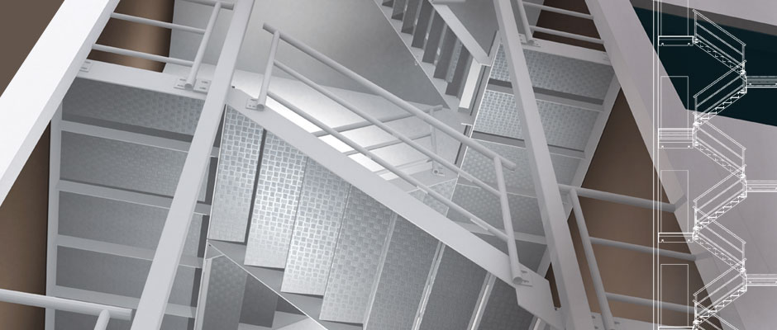
BCA SECTION D – NCC VOLUME 1
Class 9b – Relevant Section D parts
Performance Part -
DP3 Where people could fall (a) 1 m or more; …………
(f) constructed to prevent people from falling through the barrier; and
(g) capable of restricting the passage of children;
DP3(g) does not apply to—
(a) fire-isolated stairways, fire-isolated ramps, and other areas used primarily for emergency purposes, excluding external stairways and external ramps
This clause fails to meet the actual Performance requirement of DP3 a)
Even Class 1 stairs need this. This is a total contradiction WHY?

Slide 14
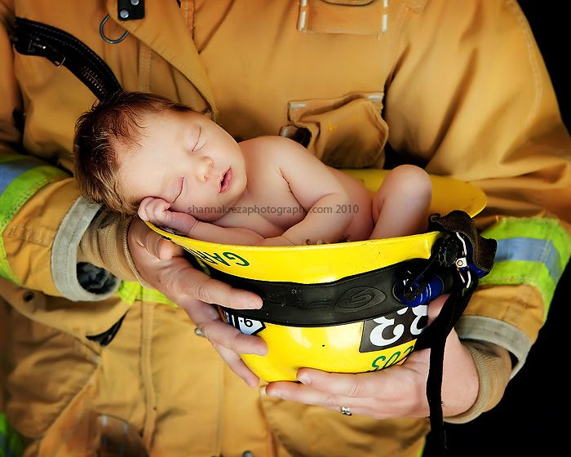
BCA SECTION D – NCC VOLUME 1
Performance Matters :-
    DP4 Exits must be provided from a building to allow occupants to evacuate safely, with their number, location and dimensions being appropriate to—
    (a) the travel distance; and
    (b) the number, mobility and other characteristics of occupants; and
    (c) the function or use of the building; and
    (d) the height of the building; and
    (e) whether the exit is from above or below ground level.
How are children catered for here? Some are infants only 6 months.
They must be under DP4 based on b) the number, mobility and other characteristics of occupants
However, the D-t-S provisions do not prescribe accessible solutions for occupants with age disability (children) despite the mandatory Performance Requirements requiring exits and warnings being appropriate to the number, mobility and characteristics of occupants. So what to do?

Slide 15
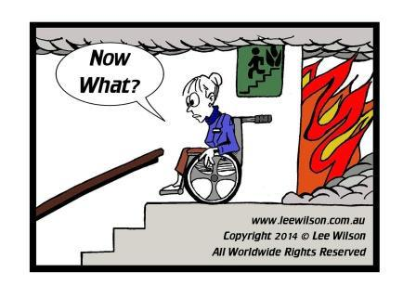

IS AGED CARE DIFFERENT FROM CHILD CARE
NCC Defines Residential Care as :
Residential aged care building means a building whose residents, due to their incapacity associated with the ageing process, are provided with physical assistance in conducting their daily activities and to evacuate the building during an emergency.
BUT… incapacity for children to evacuate without physical assistance is the same. Children under 24 months have limited ability to use a stair. So there is total dependency on an adult. This makes this occupants class – disabled in the true definition.
Children do not respond to fire alarms, follow directions, or have the ability to evacuate without assistance.
This classes these occupants as - disabled under all state Acts.

Slide 16
What design tools to use to ASSESS
evacuation of children
LETS GO BACK TO NCC DP3, DP4 - WHAT THIS MEANS:
What DP3 g) exception states is that a child is not catered for in a fire isolated exit like adults are. The danger of a child falling through a fire stair balustrade is real.
It does not allow for the restraint from fall of an infant or small child in an evacuation
What if the stairs are to an older NCC or BCA edition. How do owners modify an entire exit system. It means that a Child Care Facility using a fire escape is at risk of a death or injury under both the DtS and Performance !!
That’s setting owners up for failure and the NCC must change
However, DP4 states the design must have added reasoning.
DP4 - If we can get things right for the most vulnerable building users, children and the aged, we get them right for everyone else also. This is now essentially an issue of disability.
Assess speeds and use of stairs by children in a high rise as a means of escape. It is enough.

Slide 17
What design tools to use to ASSESS
evacuation of children
ACCESS AND EGRESS:
What to do in a fire escape. The BCA was developed (1980’s) with no infant or child evacuation assessment, speed of travel or studies that accommodates fire evacuation from height. (Fire Code Reform Centre)
What is known now is that Child Care in high rise was never a consideration in the BCA of old. This is a new and modern phenomenon
What is needed is a fresh look and understanding that children in high rise for evacuation changes with age and the density of adult carers varies to cater for the movement of infants and children
Abilities to traverse a stair is developed in the assessment tools for Fire Engineers from International and local studies. (Ferm Engineering and Chris Buck)

Slide 18
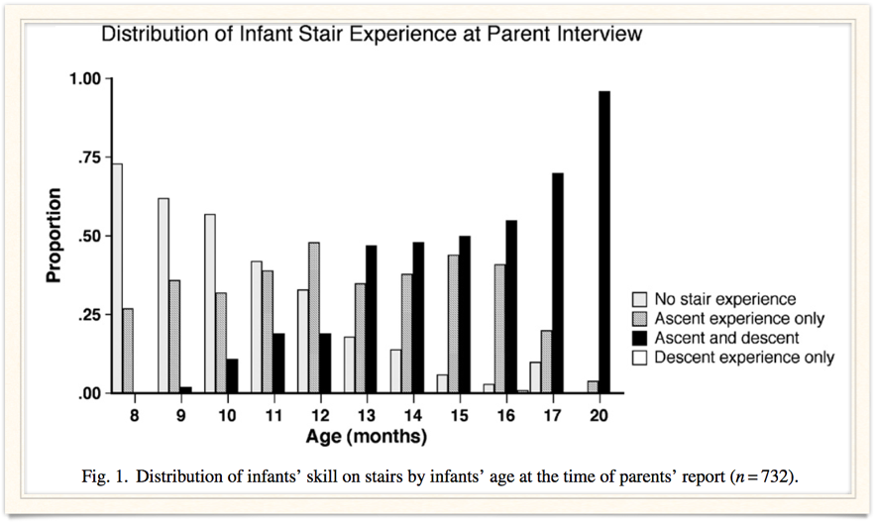
What design tools to use to ASSESS
evacuation of children
ACCESS AND EGRESS:
Infants are at greater risk from falling down stairs than toddlers or older children (National SAFE KIDS Campaign, 2004)
Stairs pose a potential danger for newly mobile infants and toddlers. Nearly, 1 million people are treated in hospitals for falls on stairs and steps each year, and in 2002 (Bayley, N. (1969)
Takes at least 20 months for infants to use a stair on their – but at their own pace
REF: Bayley scales of infant development (1969)
How and when infants learn to climb stairs: College of Staten Island, The City University of New York (2006)

Slide 19
FIRE SAFETY REQUIREMENTS
The nature of the problem is twofold.
Firstly it relates to life safety and the inability of children (disabled) being able to evacuate buildings in the event of an emergency
Secondly, the nature of the problem involves obligations under disability legislation for Landlords and Licensees to ensure, that equitable access to and within buildings, including its fire safety features, is provided for people with disability - which a child of 1 -24 months or 2 -5 years applies
It is unlawful to discriminate against a person because of their disability (or age)
But children have no voice in this, only the parents and community who take on the issue.
This is purpose of this presentation.

Slide 20
HOW TO ASSESS THE SAFE EVACUATION OF CHILDREN
Hazards are around the exit pathways, distances involved
The Children's Behaviour in Emergency Events
Determine the response time of child in an emergency
Add the response time of the carer in charge of a group of children
What speed can they collectively find the exit, assisted egress method
How do they evacuate, only by the stairs, ramp, or use of a lift, other?
What do other occupants do in the process. Access width with adults
What data and tools do we have to make such assessments or models

Slide 21
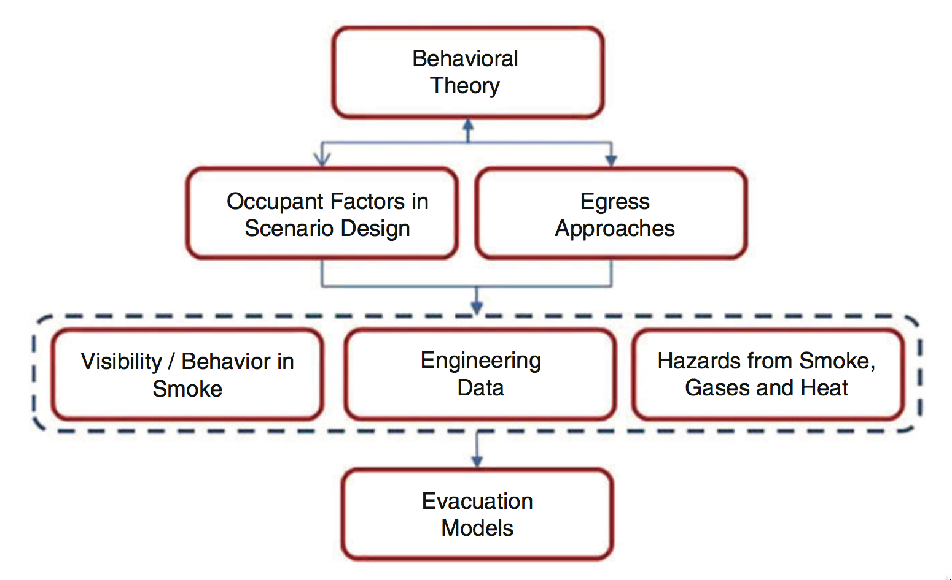
HOW TO ASSESS THE SAFE EVACUATION OF CHILDREN
Quantifying Egress (SFPE HANDBOOK)
REF: S.M.V. Gwynne and K.E. Boyce
Behavioral Theory of Children is limited in
Emergency Scenarios.
Studies in organisations that have structured
Evacuation drills and procedures need
to be studied and adapted.

Slide 22
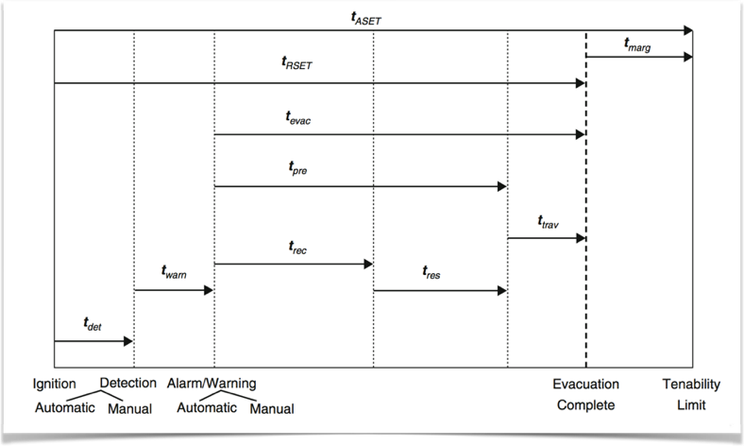
HOW TO ASSESS THE SAFE EVACUATION OF CHILDREN
The Evacuation Stages Being Considered
ASET and RSET
TIMELINES

Slide 23

HOW TO ASSESS THE SAFE EVACUATION OF CHILDREN
Child development is in stages and is not consistent with adult norms
Those infant years where the cognitive and physical capacity to behave and react to emergency and fires are not developed. This is from the NFPA study and development of their fire safety education programs, not considered in the Australian National Quality Framework (NQF) programs
Staff ratios in proportion to these development stages to assist in egress is vital
If the parent is in the same building, the interactions in an emergency are to return to the care facility

Slide 24
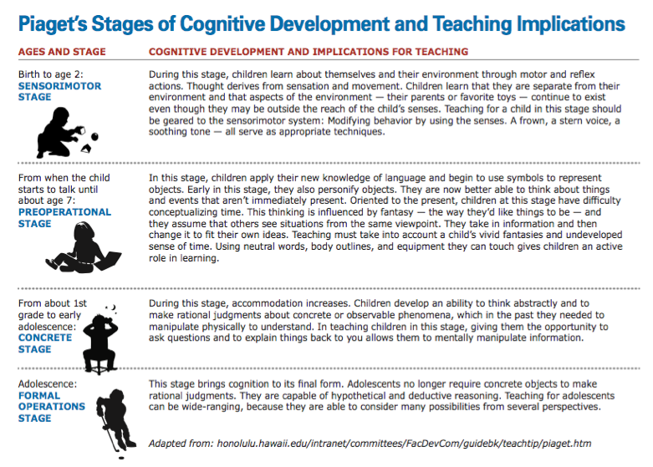
STUDY OF CHILD BEHAVIOUR
Child Development
Guide by Piaget and
Learning Safety

Slide 25
BUILDING AND FIRE SAFETY HAZARDS
Children have to be locked in and monitored by staff to prevent the “escape artist”. Their environment is also one of stimulus and play. This is similar to dementia in an aged care facility.
The rooms contain a mix of plastic toys, paper and art materials, small wooden and plastic furniture, carpets and soft padding. Fire loads are scattered.
Flammable liquids maybe in cleaning areas, there are offices and infant rooms have beds, cots, pillows and blankets. Sleeping is one of the activities to be addressed.
Facilities and rooms will have heating and cooling equipment, lighting and displays for pets like fish, reptiles, TV’s IPADS, and video players. Electrical appliances.
Clothing is often seasonally based, with minimum clothing, no shoes often. This impacts on comfort once outside and on the street below. This affects responses.
Fire loads are of domestic proportions, offices for small people, so referenced guidelines propose 600 MJ/m² REF: THE NATIONAL BUILDING CODE OF FINLAND

Slide 26
FIRE EGRESS CONSIDERATIONS AND DATA
Human child behaviour in fire is not adequately supported by the data available and this should be understood before interrogating the data-sets presented
Data can be obtained using a variety of research methods and data collection techniques
The reliability of the results, validity to the correctness of the study findings is subjective to location. Data from Japan will be less useful in Australia as the cultural and education processes are different.
Field investigations (drills, etc.). These may be announced or unannounced. Depending on the nature of the experiment, the population involved may have some forewarning of the event, may not be exposed to deteriorating environmental conditions, and/or may become aware that the event is not real. All of these may influence the external validity of the results produced.
We present field test trials from local drills in Brisbane

Slide 27
FIRE EGRESS DATA - REVIEW
Drill of local Child Care Facility:
Assessed by Observation, Fixed Camera, 2 Roving Cameras and Participants
Pre-movement times in this case are skewed to shorter than normal Stnd Deviations.
These are dealt with on separate observations and staffing levels.
Result Summary:
    Speed of Child Down a Stair 0.10 - 0.12 m/sec (Age group 12-22 months)
    Flight 2.95m High with 17 stairs, 175mm rise
    4 Staff on the 1 flight with 8 children maximum
    Time for 1 child per flight was 25.8 sec (26 -29 sec)
    Stair was not able to pass more occupants, blocked to others
    Total First Floor evacuation time 2:25 seconds (18 <2yrs +6 adults down 1 stair)
    Total Third Floor evacuation time 2:38 seconds (76 >2 + 8 adults down 1 ramp)

Slide 28
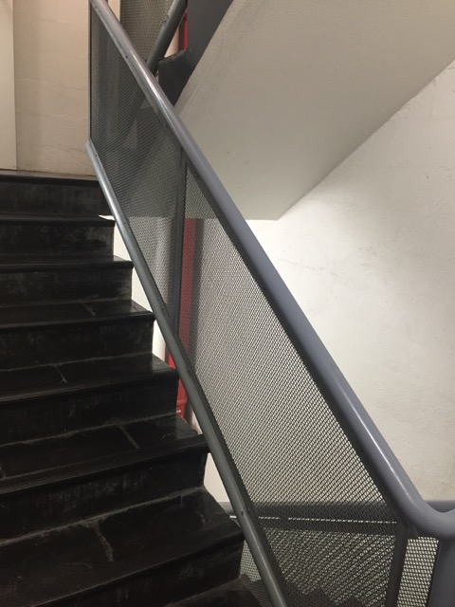
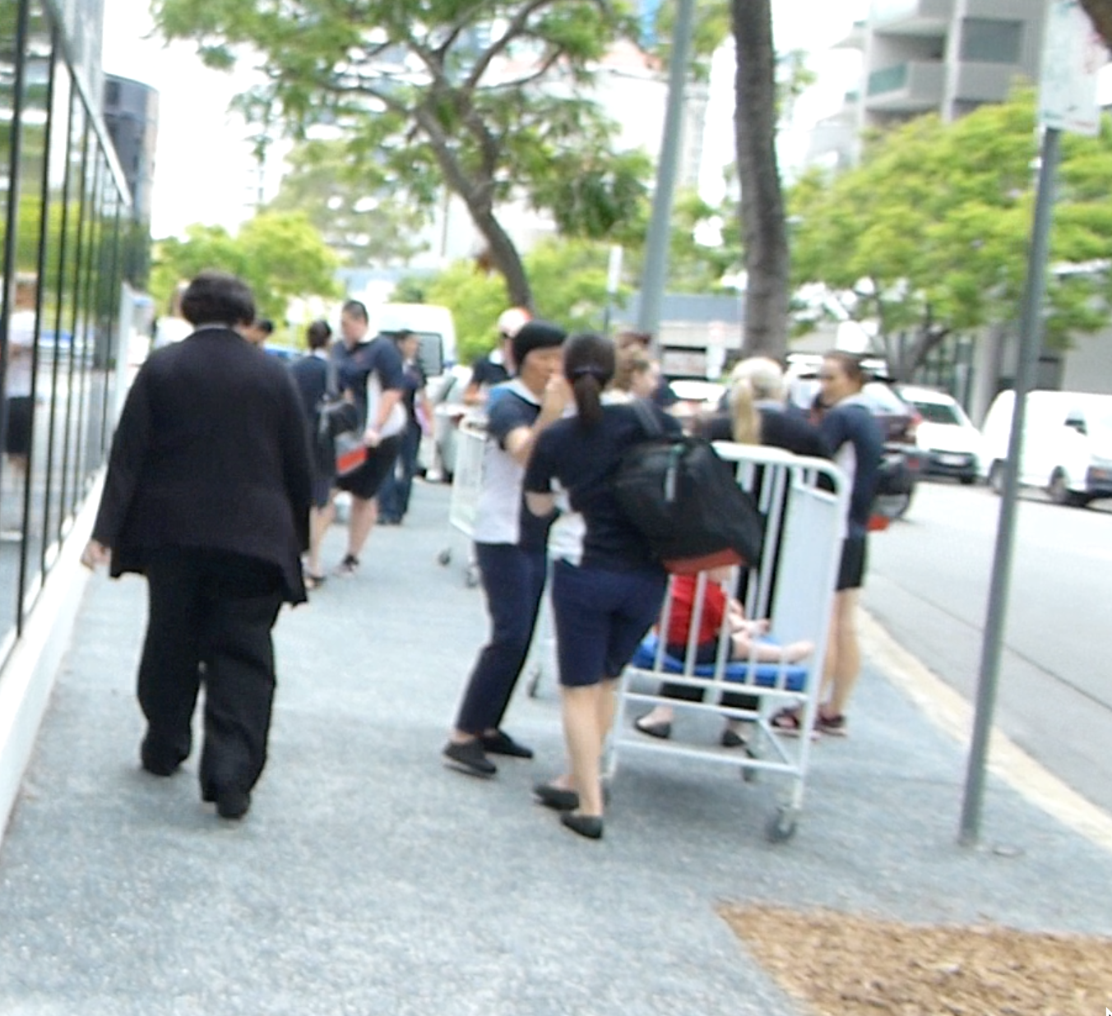
FIRE EGRESS DATA – REVIEW FROM DRILL

Slide 29
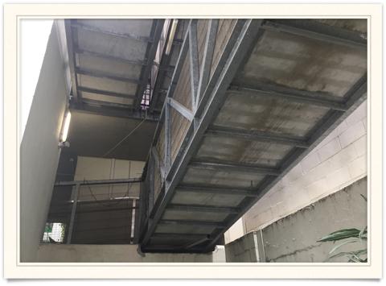
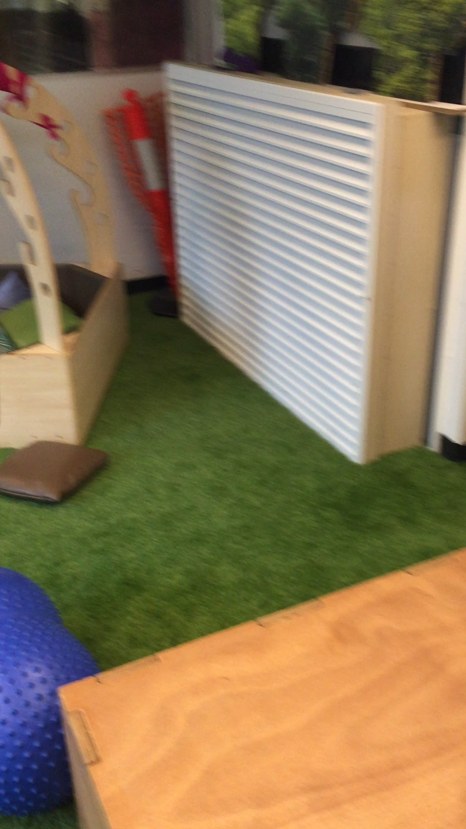
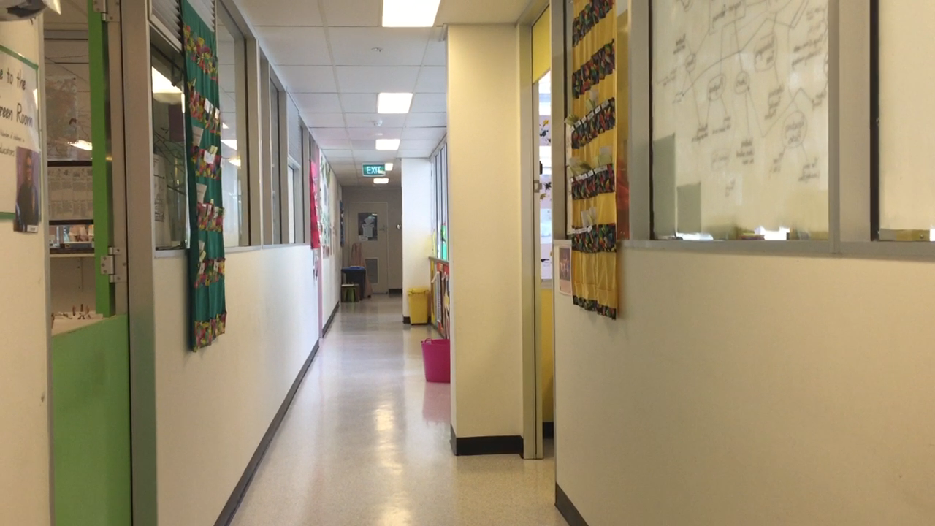

Slide 30
FIRE EGRESS DATA - REVIEW
Of critical importance here is whether the staff were aware that it was a drill/experiment rather than a real incident. Staff were aware of the drill in this data sample.
Pre-movement times in this case are skewed to shorter than normal Stnd Deviations. Children were not at sleep which occurs in the afternoons.
Children were not at random locations in the area, they were in gathered locations which meant there was high densities in corridors and at the top of stairs, which was observed.
Use of Cots to remove from the Ground floor was crucial in the fast responses to outside and reaching the assembly areas. These were city streets and footpaths, uneven and bitumen.
Time for Total Evacuation were recorded at the exit ramp or stair deemed a safe space. NCC deems that the exit point. Travel time to the assembly areas was + 2 minutes on average.
In summer, these surfaces will reach 60C and burn small feet in seconds. Clothing play a part. Russian Kindergarten (2 levels) tests vary from 60 seconds in Summer to 450 seconds in winter, needed to dress the children to stay outdoors.
Factors must be considered in the transport times from each element with and outside the building.

Slide 31
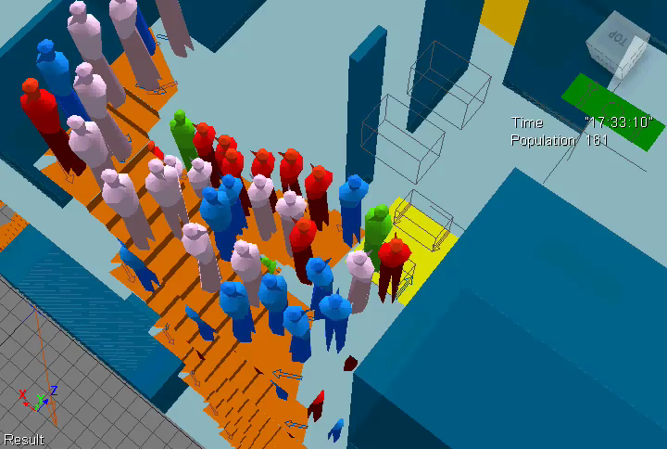
WHAT TO COMPARE WHEN MODELLING
A Conventional Evacuation Model – does not cater for children

Slide 32
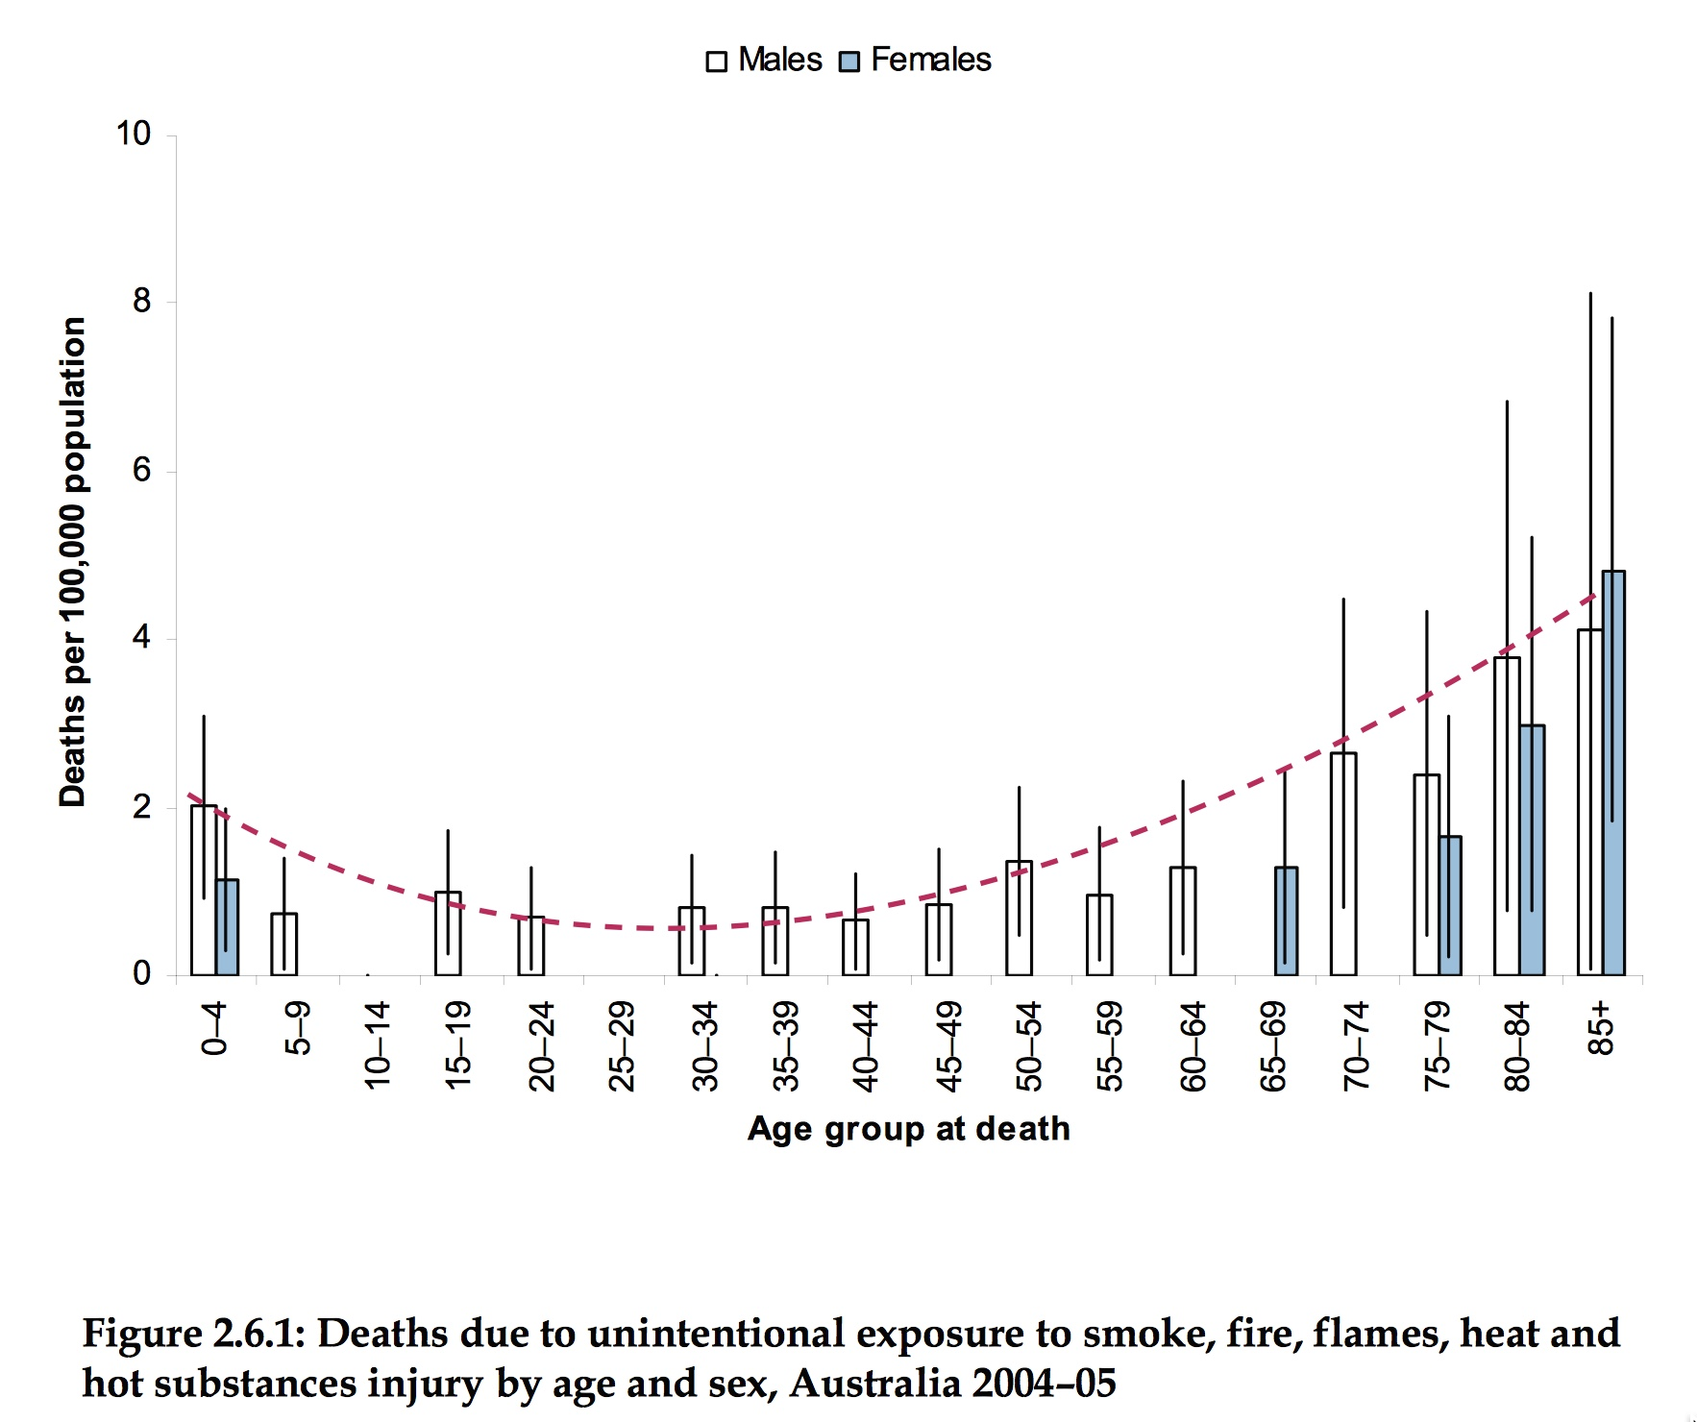
FIRE EGRESS DATA - REVIEW
Death from fire is a statistic that follows a trend. It is higher per 1000,000 persons in the elderly and children under 6.
A report from Australian Institute of Health and Welfare in 2005 shows the trend. See graph Figure 2.6.1.
Note the shape, children and aged care rise in similar proportions.
Many children in Australia die, in similar numbers to drowning.

Slide 33
FIRE EGRESS DATA - REVIEW
The importance of this review of egress data is the ability for a PEEP process and staff training to act reasonably well. Daisy chains with ropes is an effective method, holding hands
The difficulty for mixed class 9b + 5 + 2 facilities is they have adult interaction in the stairwells and managing the numbers and head counts of the Children.
Parents returning to get their child may create reverse flows in stairwells.
In the World trade Centre attack, the Child Care facility there was evacuated by the staff. Each Teacher carried 2 children under 24 months and older children with a change link of holding hands. WHS limits carry loads by staff and each staff member may have own limits.
In other OS emergencies, there are reports of child abductions during events, children missing. The fire stair in a 5 - 32 storey tower will be uncontrolled and unsecured for a child.
Reaching the assembly areas are uncontrolled, as wandering and escaping children is a real issue as is placing them on a city street, cars, buses, trucks and people is uncontrolled.
Emergency services do not have a known record for these evacuations, use of lifts and children at multiple exits. Needs a holistic approach and ongoing cooperation.

Slide 34
5 DESIGN TOOLS
Design Tools for the assessor and the fire safety engineer are needed, but we only have adult data
NCC has a DtS arrangement that is for ambulant adult and young children in low densities in high rise evacuations.
High rise Child Care facilities places a high density of disabled young persons into stairs with inadequate designs for their smaller size. Stairs will be blocked
Potential to fall is higher, handrails are crucial
Floor finishes and footwear slow down the pace and staff have to handle a child every step by holding hands and a maximum 2 children per adult <2 years old
Any one facility can have 200 children, with 80 infants. That takes time to move down from 3 storey let alone 20 floors.
So what evacuation tools are needed. Stairs alone are not the answer.

Slide 35
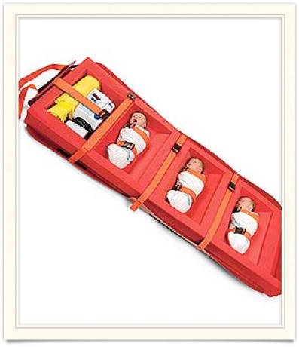
DESIGN TOOLS
Fire Systems need to be appropriate to the space and height. DP4 will lever into EP2.2 and CP2
There are solutions - Building Tools to be considered are:
Lifts for Egress (ABCB Guide on Lifts - free)
Guidelines for designing fire safety in very tall buildings (SFS)
Fire Evacuation Equipment (US and UK based)
Safe Haven Locations for Pre-stair movement
Smoke Compartments and Pressurisation for the floor or stairs
Add ramps (or drop chutes) in addition to stairs
Sprinklers and the use of Quick Response heads
Early warning detection and staged evacuation
Management procedures form the basis for success (PEEP)

Slide 36
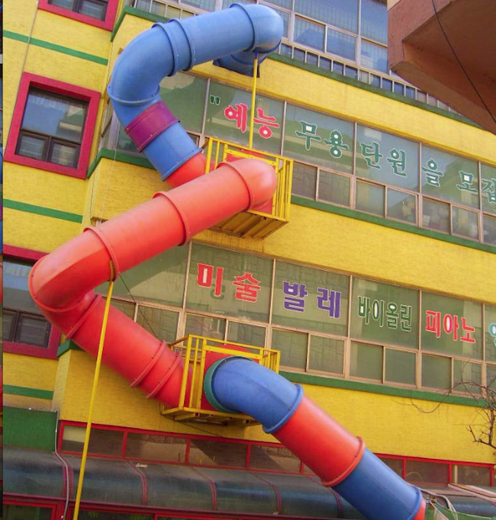
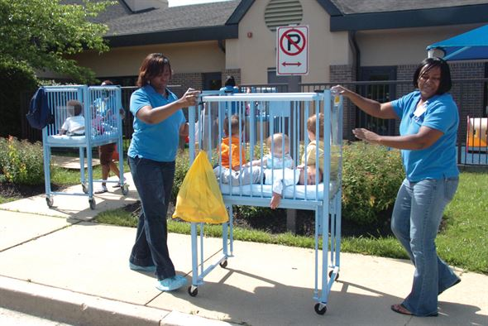
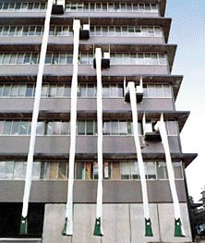
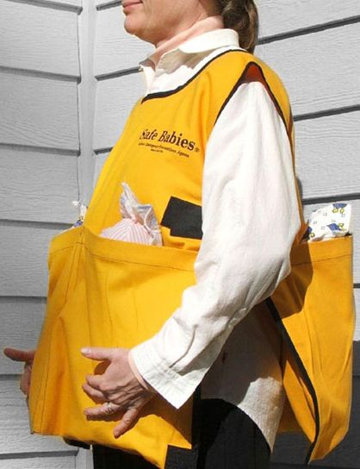
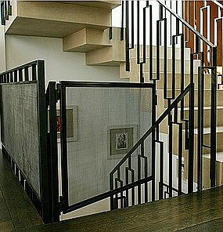
DESIGN TOOLS

Slide 37
6 DESIGN, POLICIES, EDUCATION AND
PROCEDURES
Solutions Exist now with simple changes to both the Planning Schemes, the Local Government and Department of Education procedures. A set plan to change legislation to accommodate “reasonable mans” test.
Recommendations
A. The chief executive in charge of the Acts, makes conditions on all approvals to multi-storey child care facilities to have them submit and respond to give proof of safety in fire. Part 22 and 33 of the Acts.
B. Have expert fire and building code advice in the assessment process added to the Education Departments application program.
C. A change to QDC MP2.2 or a new MP5.4 to include conditions for child day care and aged care day respite facilities for fire safety. Prescriptive measures in the QDC and NCC does not address egress for young children or temporary sleeping use. (Both Aged Care and Child Care)
D. Add into MP2.2 a definition for “evacuation impairment” to extend to both children under 6 years and the infirm in temporary day care facilities, as they must be recognised and added to legislation for their fire safety needs

Slide 38
6 DESIGN, POLICIES, EDUCATION AND
PROCEDURES
E. Added conditions or procedures for operators in high rise locations (above 2 levels) to place child evacuation controls and transport apparatus to ensure carer ratios can evacuate occupants and staff are trained to use apparatus.
F. Amend the Local Town Planning City 2014 guide to cover the risk factors in the High Rise sectors and place condition for Child Care in those sectors. The factors are incorrect in the plan currently. Restriction on use and height instantly solves the issue for risk mitigation in the future.
G. Development of a Fire Safety in Child Care Guideline. Society of Fire Safety of Engineers Australia will assist in that process.
H. Awareness campaign and guidelines to owners and for new applications of expected fire safety education and fire evacuation guidelines.
I. Undertake mandatory witnessed evacuation drills and staff training registers as per the Aged Care style of record keeping.
J. Placement of occupancy categories and added fire safety provisions in the prescriptive aspects of the NCC and adoption of reformations by the ABCB for the upcoming NCC 2019.
K. Use of Personal Evacuation Emergency Plans (PEEP) for the Child Care Facilities Directly, and registered as part of the Approval for the Building permit and Child Care Operators License.

Slide 39
DESIGN GUIDES AND SYSTEMS
There management solutions - Procedures
Staff Induction and training is paramount
Guidelines to Emergency Evacuation Planning Guide for People with a Disability (NFPA)
Cots and Trolleys and Skids that accommodate more children to ease staff/child ratios and stress and loads
Assembly areas with back-up locations for safe external environment
Sock/booty ages that staff grab with Fire Backpack kits - to assist the little feet to handle harsh surfaces
Food and pacifier kits for infants
Drills and team training, child lists in paper
Assessment and audit with a registered NER fire engineer (1 /year)

Slide 40
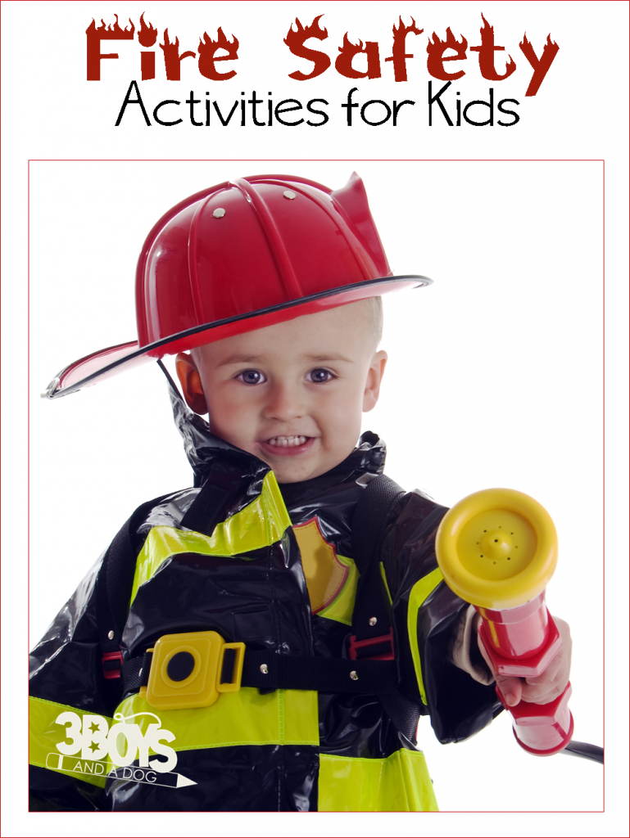
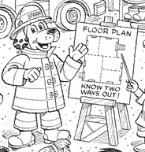
7 EDUCATION IN FIRE SAFETY

Slide 41
EDUCATION IN FIRE SAFETY
There are no current education solutions used as a National platform to educators.
There are many new centres planned and large corporate buyouts and Investment Companies are moving into the market. This market is attractive to investors.
  http://www.greenfinancegroup.com.au/commercial-finance/childcare-centre-finance/tips-for-buying-a-childcare-centre/
The Victorian Government alone has committed $50 million over four years to support local governments and other service providers to invest in early childhood infrastructure
No moneys have been allocated for fire training in Early Childhood centres
NFPA in the US runs the Child Care training program, UK has Fire Safety Advice Centre
Asian countries include significant child education on evacuation in emergencies, fire, tsunami, earthquake, etc.
State Fire authorities have limited “On-line” programs and there is no national focus on early childhood fire safety and education. So this forms part of the overall evacuation processes, knowing what to do when asked by carers and parents and at home.

Slide 42

CONCLUSION - DO IT FOR THE KIDS
THANK YOU FOR YOUR ATTENDANCE

