Slide 1
Evacuation Modelling of Stadia using MassMotion
Rebecca Lawson and Oliver Gibson

Slide 2
Outline
Project description
About the location – Allianz Stadium
Software
MassMotion
Modelling Results
Concert
Real-life observations
Key Findings & recommendations

Slide 3
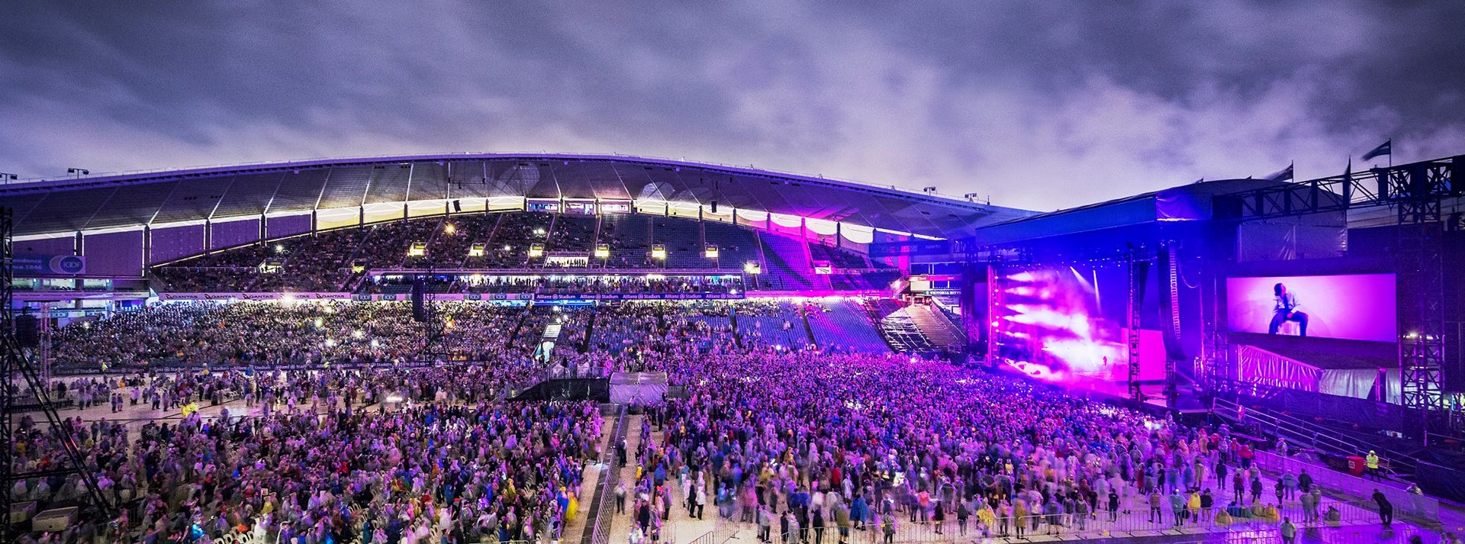
Project description
Allianz Stadium | Sia Concert | Evacuation Modelling

Slide 4
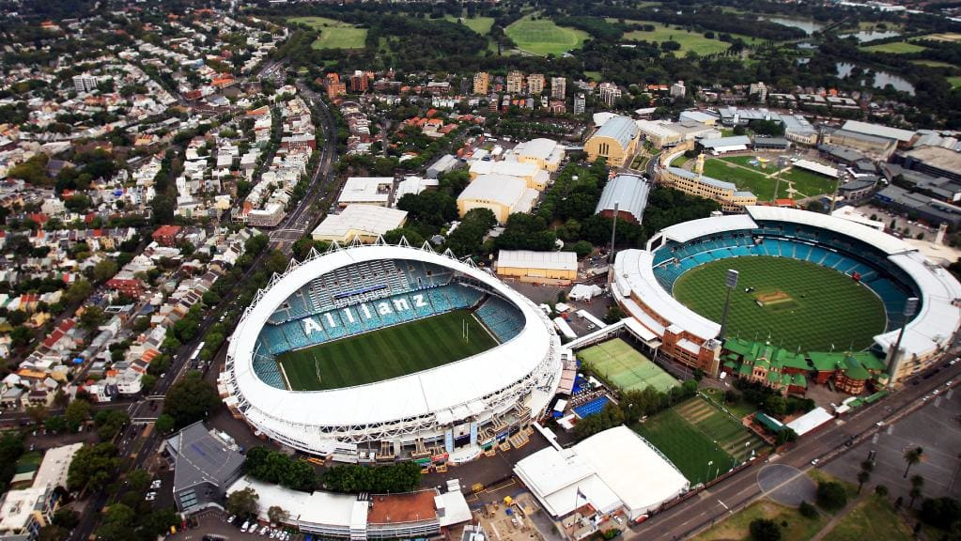
About the location – Allianz Stadium

Slide 5
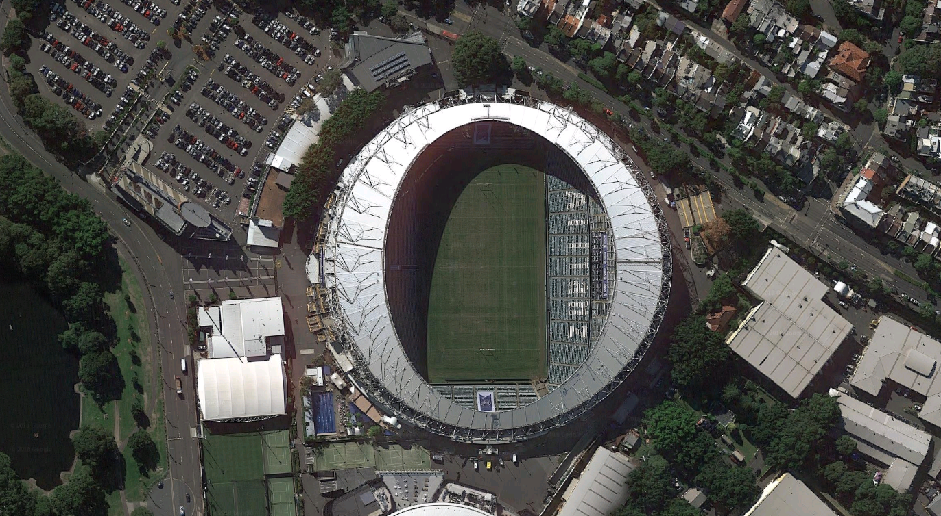
Stadium Concert Layout
Car Park
NW
Stage
To City
Moore Park Rd
To Central station
Tractor Chute
Driver Ave
To Buses
Sydney Cricket Ground
To Buses

Slide 6
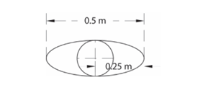
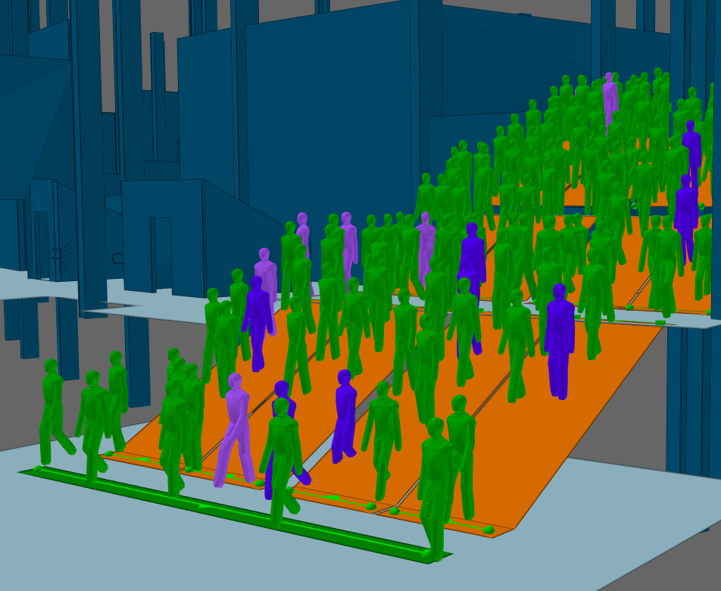
MassMotion – Inputs and assumptions
Simultaneous evacuation
Agent speed
Normal distribution
Fruin’s pedestrian planning & design
Agent dimensions
Maximum population
Disabled access

Slide 7
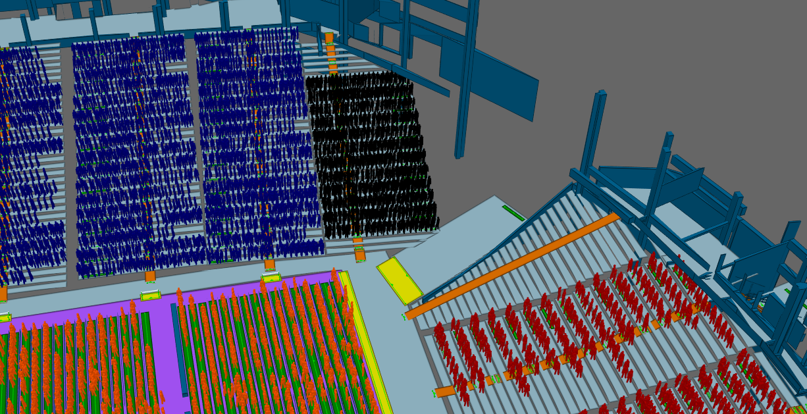
Construction of Model

Slide 8
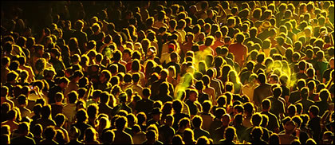
Acceptance Criteria
Queuing Times | Densities | Green Guide
Max time queuing
Density limit 4 people/m²
8 mins

Slide 9
Results – MassMotion

Slide 10
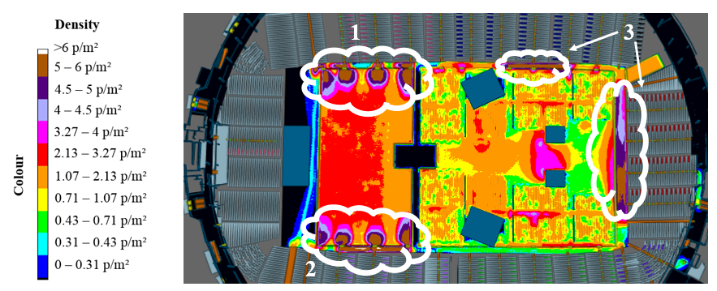
Results

Slide 11
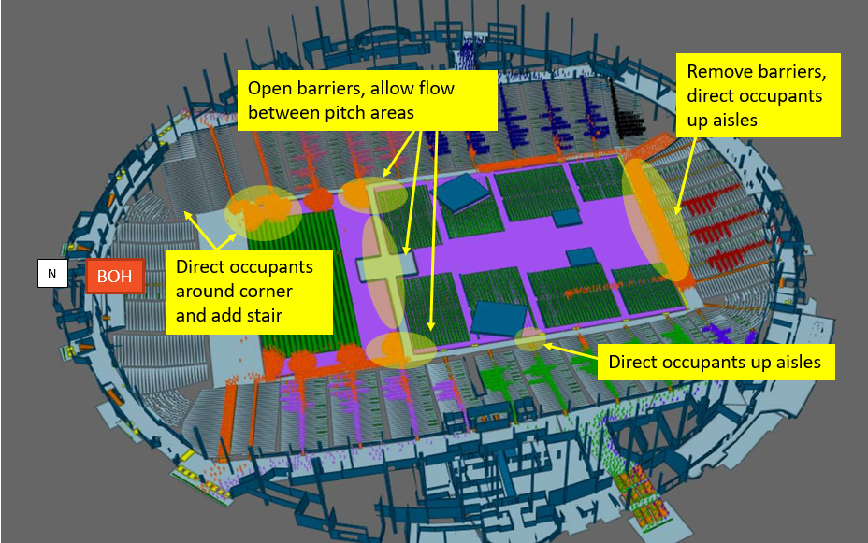
Recommendations
More exit width
Additional stair
Use aisles
Open up barriers

Slide 12
End of Concert Egress

Slide 13
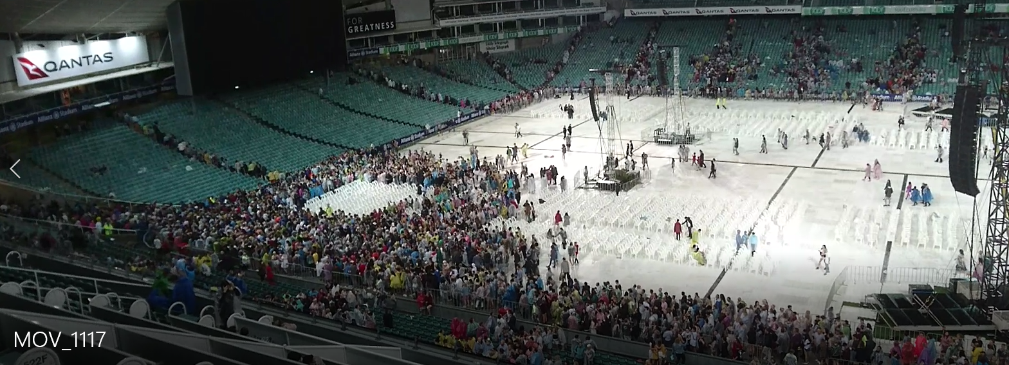
Observations - Human Behaviour
NW Temporary Stair – Entry point
Tractor Chute – Toilets / Bar/ Food
NE Temporary Stair – Exit only

Slide 14
Precinct Movement
Car Park
NW
Stage
To City
Moore Park Rd
To Central station
Tractor Chute
Driver Ave
To Buses
Sydney Cricket Ground
To Buses

Slide 15
Key Learnings and Recommendations
Why did people move away from less congested exits routes?
Exit familiarity (fire engineering)
Stadium layout (pedestrian planning)
Differences in occupant behaviour between model and real-life
Client was highly responsive to recommendations → valuable exercise
Design the stadium layout and exit capacity for evacuation and egress at initial stages of design so that there will be less congestion and queuing due to human behaviour to manage.

