Slide 1
Building Fire Spread Yaping He School of Computing, Engineering and Mathematics Western Sydney University

Slide 2
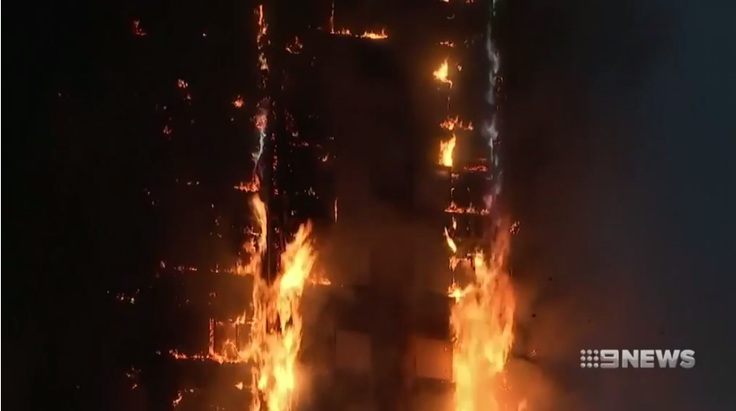
Grenfell Tower Fire - Renovations with deadly cladding

Slide 3
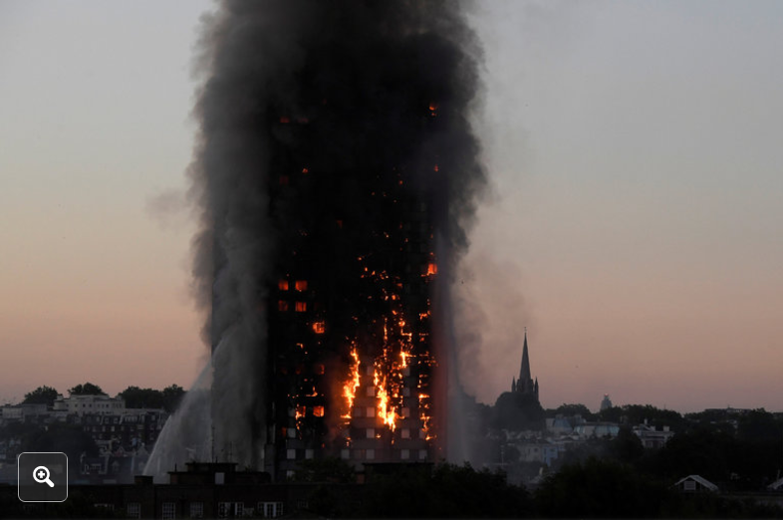

Slide 4
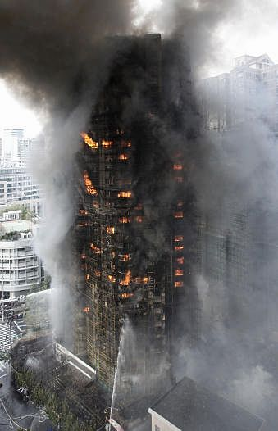
Lessons have not been learnt
Shanghai fire, 2010 (58 fatalities)
Melbourne Lacrosse Building fire, 2014 (no fatality)
Shanghai fire
Lacrosse Building fire

Slide 5
Energy efficiency and fire safety - Conflict and trade-off
Energy efficiency
Better insulating materials
Low embedded greenhouse gas emission materials
Fire safety
Non-combustible materials (usually with high embedded GHG emissions)
Fire resistant materials (usually with high embedded GHG emissions)

Slide 6
Comparison of material properties
Material | Density (kg/m³) | Thermal conductivity (W/mK) | Heat of combustion (MJ/kg) | Source
Normal Concrete | ~ 2400 | 0.15 ~ 1.6 | 0 | Website 1 & 2 (2017)
Lightweight concrete | 160 ~ 1920 | 0.1 ~ 0.3 | 0 | Website 1 & 2 (2017)
Aerated concrete | 300 ~ 1600 | 0.11 ~ 0.135 | 0 | Website 1 & 2 (2017) Pruteanu (2013)
Polymer | 836 ~ 1523 | 0.05 ~ 0.51 | 7 ~ 45 | Website 2 & 3 (2017)
Polymer foam | 96 ~ 577 | 0.03 ~ 0.043 | 7 ~ 45 | Website 2 & 3 (2017)
Timber | 600 ~ 1100 | 0.12 ~ 0.17 | 15 ~ 20 | Tewarson (2008)
Polyethylene LD | 950 | 0.45 | 41 | Tewarson (2008)
Polyethylene foam | 24 ~ 27 | 0.04 | 41 | Tewarson (2008) Martínez-Díez et al. (2001)

Slide 7
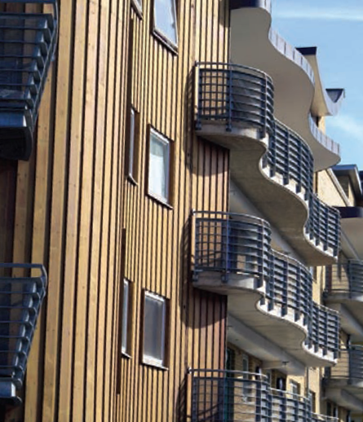
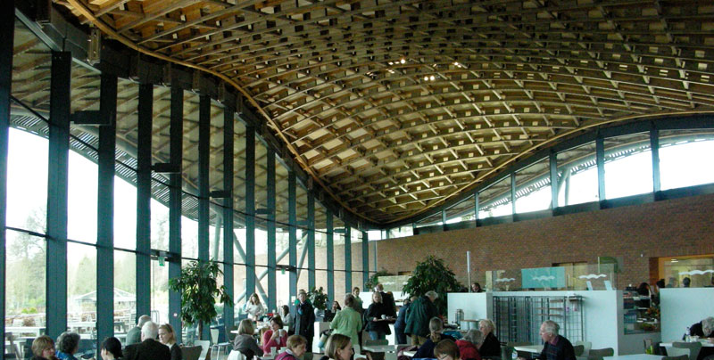
Timber Buildings

Slide 8
Fire Spread
Internal spread within a building
Horizontal spread between compartments
Vertical spread through floors/ceilings, stairs and shafts
Exterior spread
Along the envelop of a building
Between levels
Exterior spread between buildings
Via thermal radiation
Flame and/or ember
(O’Connor, 2016)

Slide 9
Internal spread within a building - Protection measures
Fire suppression systems
Fire extinguishers;
Hose-reels;
Sprinklers.
Compartmentation
Fire rating compartment boundaries: walls, ceilings and floors;
Fire rating of openings: doors and windows
Protection of penetrations: cable and pluming penetrations

Slide 10
Compartmentation - Fire resistance design
Fire resistance level (FRL) vs fire severity (FS) analysis (timeline analysis)
FRL > FS
FS depends on
Fire load
Ventilation condition
Interior lining of the compartment
(Spearpoint, 2008)

Slide 11
Combined sprinkler and compartmentation system
Eurocode approach (EN-1991-1-2)
Empirical correlation and safety factors
Risk based approach (He and Grubits, 2010)
Comparative failure probabilities

Slide 12
Exterior Spread between buildings
Verification Method CV1 and CV2

Slide 13
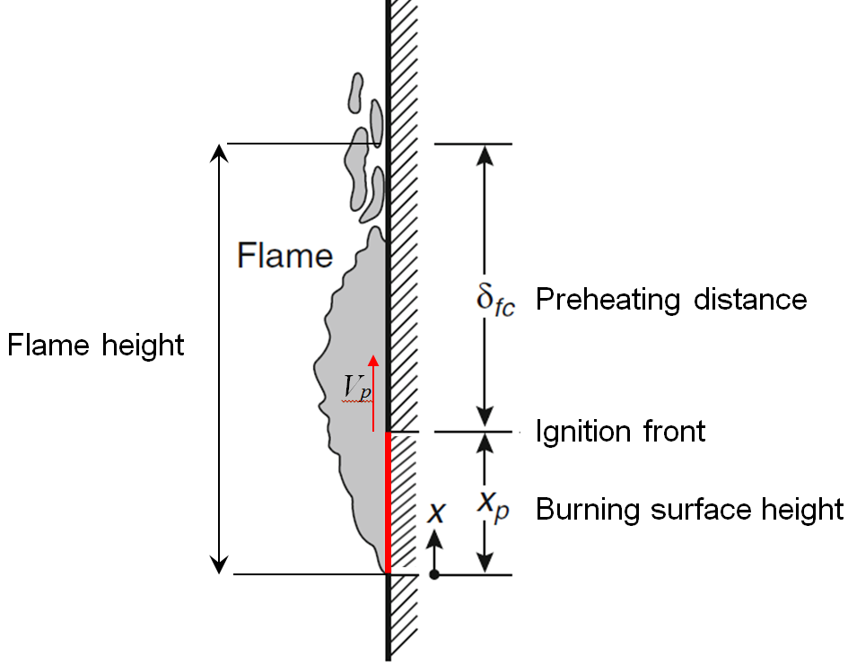
Fire exterior spread along building envelope - Evaluation methods (Hesami, 2016)

Slide 14
Estimate of surface flame spread Vertical flame spread velocity
$$V_{p}=\frac{4δ_{fc}}{πkρc}{\left(\frac{{\dot{q}}_{f}^{"}}{T_{ig}−T_{o}}\right)}^{2}$$ | (1)
where V_{p} = flame spread velocity (m/s)
k – thermal conductivity (W/m K)
ρ – density of the fuel (kg/m³)
c = specific heat (J/kg K)
T_{ig} = ignition temperature (°C)
T_{o} = initial temperature (°C)
qf" = flame heat flux (W/m²)

Slide 15
Flame height and preheating distance
$$δ_{fc}=x_{f}−x_{p}$$ | (2)
$$x_{f}=k′{{\dot{Q}}_{l}}^{2/3}$$ | (3)
where x_{f} = flame height (m)
k’ = coefficient (0.043 ~ 0.067 m^{1/3}kW^{-2/3})
${\dot{Q}}_{l}$ = heat release rate per unit width of the fire source
(kW/m)

Slide 16
Burning surface height and heat release rate per unit width
$$x_{p}=x_{p0}+\int_{0}^{t}{V_{p}dt}$$ | (4)
$${\dot{Q}}_{l}={\dot{q}}^{"}x_{p}$$ | (5)
where q"= burning intensity, or heat release rate per unit
burning surface area (kW/m²)

Slide 17
Algorithm
Start
Set initial conditions
Estimate x_{p} using Eq. (4)
Estimate ${\dot{Q}}_{l}$ using Eq. (5)
Estimate x_{f} using Eq. (3)
Add time increment
Estimate δ_{fc} using Eq. (2)
Estimate V_{p} using Eq. (1)
t > t_{end}
No
Yes
End

Slide 18
Grenfell Fire – A case study
To demonstrate the application of the method
The detailed configuration of the composite cladding is not known

Slide 19
Grenfell Tower
Constructed in 1974
24 storeys
Concrete structure
No sprinklers?
Refurbished in 2016
Aluminium composite cladding (aluminium with polyethylene core)
New windows

Slide 20
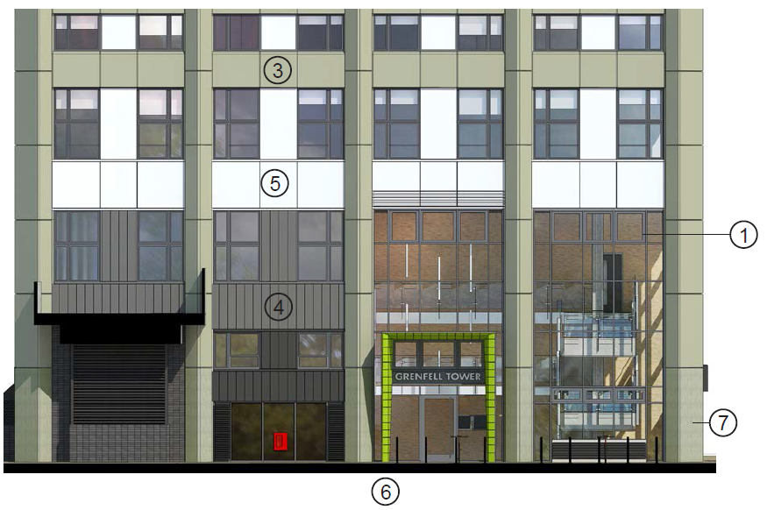
Spray paints - polyester

Slide 21
Assumptions
Polyethylene foam is without any cover
The wind effect is neglected
The cladding is continuous
The heat release rate intensity of polyethylene foam can be approximated by that of polyurethane foam
Mean flame temperature: 800 °C
Flame emissivity: 0.6
Initial burning surface height: 0.05 m

Slide 22
Input parameters
Parameter | Value | Source
k (W/m K) | 0.04 | Martínez-Díez, et al. (2001)
ρ (kg/m³) | 25 | Martínez-Díez, et al. (2001)
c (kJ/kg K) | 1.9 | Martínez-Díez, et al. (2001)
T_{ig} | 377 | Tewarson (2008)
${\dot{q}}^{"}$ (kW/m²) | 173 | Babrauskas (2016)
k’(m^{1/3}kW^{-2/3}) | 0.05 | Hesami (2016)
Δt (s) (integration time step) | 0.05

Slide 23
Results – Flame height

Slide 24
Results – burning surface height

Slide 25
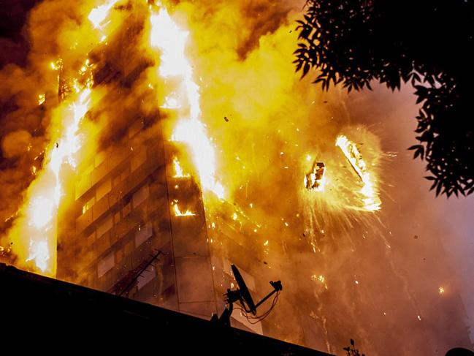
Caution
The model has not been validated against large scale vertical combustible surface
The assumptions may be too crude
The effects of other composite materials were not considered

Slide 26
Concluding remarks
Performance of energy efficiency and fire safety must be assessed together
Safety first, energy efficiency second;
New fire-resistant/fire-retardant materials with low density and low thermal conductivity need to be developed;
New fire protection technology and techniques need to be developed;

Slide 27
The New Industrial Transformation Training Centre - ARC Training Centre in Fire Retardant Materials and Safety Technologies
Aim: to improve the fire safety of lightweight materials and structures and fire protection systems utilised in a broad range of industry sectors.

Slide 28
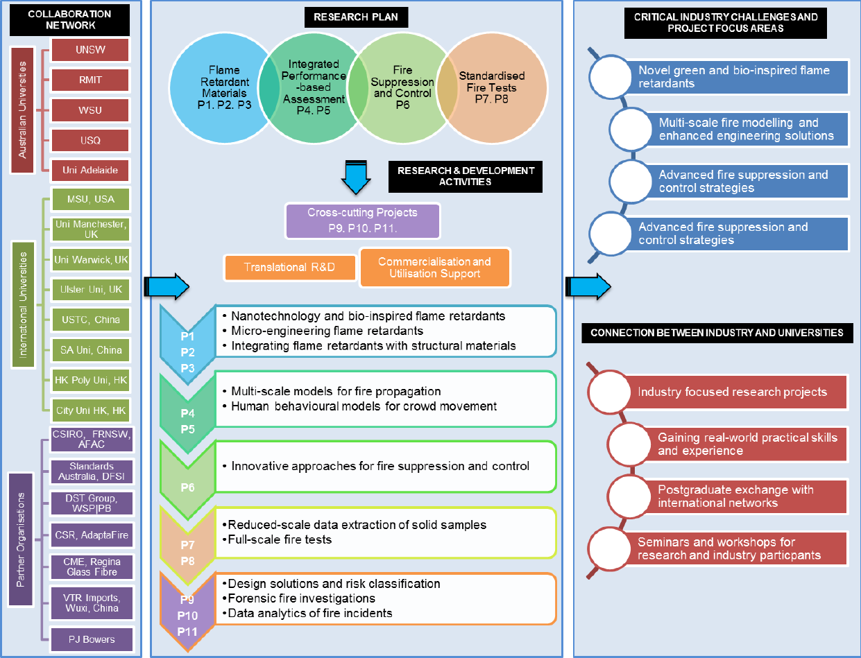
Conceptual Framework of the Centre

Slide 29
Participating institutions - 27 Research, education and industrial organisations
Australian Universities
UNSW
RMITU
WSU
USQ
U Adelaide
Intal Universities
Michigan State University
U of Manchester
U of Sci and Tech of China
Hong Kong Polytechnic U
City U of Hong Kong
…
Other
CSIRO
FRNSW
AFAC
DSTO
Standard Aust
CSR
…

Slide 30
References
Martínez-Díez, J. A., Rodríguez-Pérez, M. A., De Saja, J. A., 2001. The Thermal Conductivity of a Polyethylene Foam Block Produced by a Compression Molding Process. Journal of Cellular Plastics, 37, 21-42.
O’Connor, D. J. 2016. The Building Envelope: Fire Spread, Construction Features and Loss Examples. In: Hurley, M. J. (ed.) SFPE Handbook of Fire Protection Engineering. 5th ed. New York: Springer.
Pruteanu, M. and Vasilache, M., 2013. Thermal conductivity determination for autoclaved aerated concrete elements used in enclosure masonry walls, Buletinul Institutului Politehnic Din Iaşi, 6, 33-42, http://www.bipcons.ce.tuiasi.ro/Archive/423.pdf (Accessed 18/6/2017).
Tewarson, A., 2008. Generation of Heat and Gaseous, Liquid, and Solid Products in Fires. In: DINENNO, P. J. (ed.) SFPE Handbook of Fire Protection Engineering. 4th ed. Boston: Society of Fire Protection Engineers.
Website 1, 2017, The Physics Factbook: http://hypertextbook.com/facts/1999/KatrinaJones.shtml (accessed 18/6/2017).
Website 2, 2017, The Engineering Toolbox: http://www.engineeringtoolbox.com/thermal-conductivity-d_429.html (accessed 18/6/2017)

