Slide 1

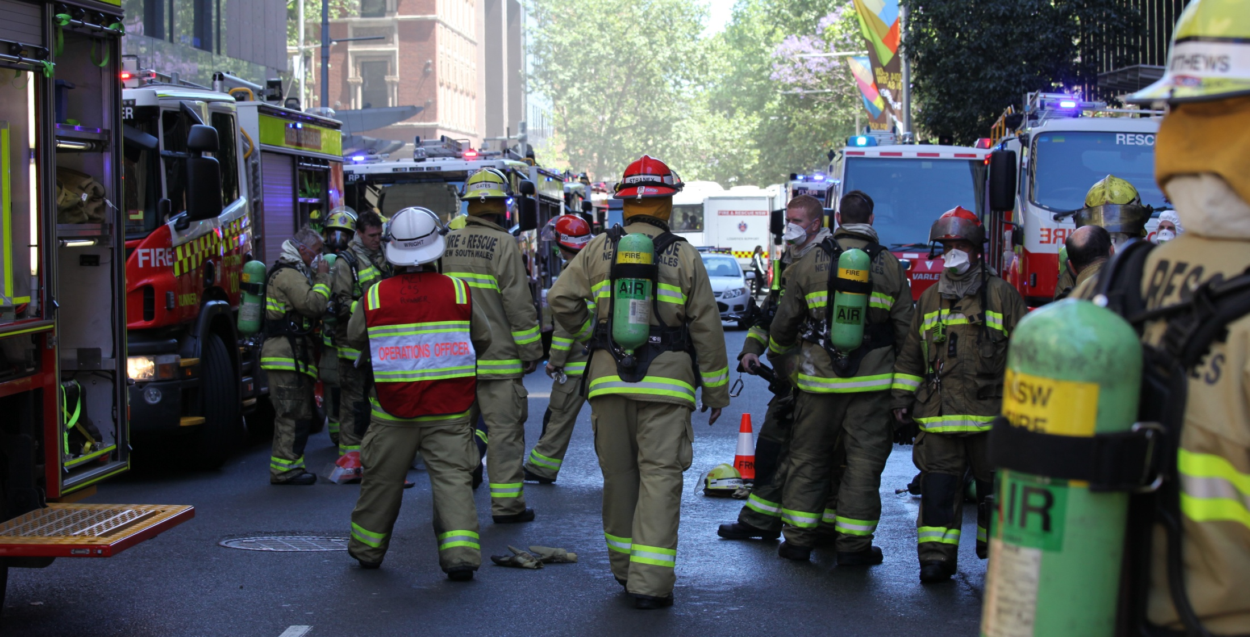

What to look at in fire engineering analysis
Jamie Vistnes
Manager, Fire Safety Policy Unit

Slide 2

Approaches and Methods of Analysis
      Absolute
      Comparative
      Qualitative
      Quantitative
      Deterministic
      Probabilistic
Notes:
2

Slide 3
1.2.9.4 Methods of analysis
There are many forms of analysis methods:
formulas, equations and hand calculations
spreadsheet calculations
statistical studies
experiments with physical scale models
full-scale experimental tests such as fire tests or trial evacuations of real buildings
computer simulation of fire development and smoke spread
computer simulation of people movement.
Notes:
3

Slide 4
1.2.9.4 Methods of analysis
The methods chosen should:
be well documented (especially their limitations and assumptions) either in the literature or by the fire engineer
be well validated
be suitable for the task
generate outputs that can be compared with the acceptance criteria agreed for the analysis
have clearly defined limitations and assumptions that are well documented.
“The FEB report should record, as appropriate, the above information for each method chosen.”
Notes:
4

Slide 5
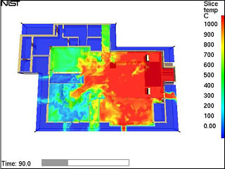
1.2.9.4 Methods of analysis
These can be summarised as needing to be:
Well documented and well validated
Suitable for the task
Used within limitations and assumptions
Generate suitable outputs to address acceptance criteria
http://www.nist.gov/el/fire_grants.cfm
Notes:
5

Slide 6
Well Documented and Well Validated
Standards available for assessing and verifying fire models
ATS 5387.3—2006
ISO/TR 13387-3:1999
Australian Technical Specification
Guidelines—Fire safety engineering
Part 3: Assessment and verification of
mathematical fire models
ASTM E 1355-97, Standard Guide for Evaluating the Predictive Capability of
Deterministic Fire Models
Notes:
6

Slide 7
A.6 Review of FRIEDMAN, R., An International Survey of Computer Models for Fire And Smoke, Journal of Fire Protection Engineering, 4, pp. 81-92, 1992
Reasons why a model may not yield results in complete accord with actual fire behaviour are:
  idealizations and simplifications on which the model is based deviate significantly from reality;
  input parameters supplied to the model are inaccurate;
  "default" values of coefficients used internally in the model are incorrect;
  the computation process yields a wrong result (due to poor choice of time steps or mesh size or due to mathematical singularities or instabilities);
  the experimental measurements are incorrect or non-repeatable.
Notes:
7

Slide 8
A.6 Review of FRIEDMAN, R., An International Survey of Computer Models for Fire And Smoke, Journal of Fire Protection Engineering, 4, pp. 81-92, 1992
It is generally risky to apply a model to conditions which are drastically different from those for which the model has been validated.
Conclusion:
Just because a model exists, doesn’t mean it is necessarily accurate and appropriate for use.
Notes:
8

Slide 9
Well Documented and Well Validated
How much effort goes in to reviewing validation and verification documentation?
How much effort goes in to investigating whether it even exists?
How much of this review is then documented in the FEB/FER?
Notes:
9

Slide 10
Well Documented and Well Validated
FDS may be considered generally well validated for predicting smoke movement in a building.
Can also be used to predict fire spread and sprinkler operation
  Questions still remain as to how accurately are these predicted.
Therefore, just because something is included in a model, doesn’t mean it can always be used.
http://www.tyco-fire.com/TFP_common/DoorWayFlowsWP.pdf
Notes:
10

Slide 11
Suitable for task
Some typical examples not considered suitable for the task:
  Egress modelling may be undertaken to demonstrate that the evacuation time is short compared to the FRL prescribed, however these times do not correlate.
  Fire Brigade Intervention is often analysed and quantified (to some extent), however not linked to the acceptance criteria
Whilst quantitative modelling and robust technical analysis is encouraged, it needs to be appropriate to the agreed acceptance criteria and not used as a “smoke screen” to fill out the report.
Notes:
11

Slide 12
Within Limitations and Assumptions
How well do you know the limitations and assumptions of a tool?
Have you looked at the basis for deriving the tool?
  For example, fire severity calculations derived from experiments in relatively small compartments.
When is it OK to move outside these limitations?
  For example, using a zone model for a 2,500m² compartment?
Again, are these clearly documented in the FEB/FER?
Notes:
12

Slide 13
Generate suitable outputs to address acceptance criteria
Can the results generated be used to demonstrate that the acceptance criteria has been achieved?
Without sufficient outputs:
  The conclusions drawn from the analysis cannot be appropriately documented
  Makes it difficult for a reviewer to determine how much engineering judgement has been used
Notes:
13

Slide 14
Use of Technical Tools - Inputs
      Obviously affect the outcome – so critical
      FRNSW experience a general lack of detail in FEB, therefore how can we agree
        Need to further work on what are considered critical to the analysis
        All inputs/assumptions clearly justified and documented
        Also often find changes occur between FEB and FER, but not documented
      Note: New Zealand Verification Method not considered an appropriate reference as this is a VM for an different country’s building code with no specific supporting references
Notes:
14

Slide 15
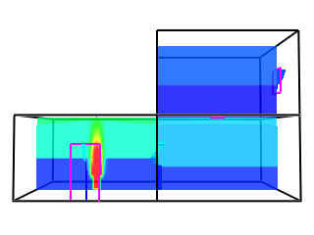
Use of Technical Tools - Inputs
      Sensitivities need to be considered, which may vary according to the tool being used
        These should also be identified at FEB stage
        FRNSW experience a wide variation in how this is considered
https://pages.nist.gov/cfast/
Notes:
15

Slide 16
Use of Technical Tools - Outputs
      Need to be sufficient to justify the results/conclusions made
      FRNSW experience a wide variation in both what outputs are shown and how they are used, for example:
        No results, only reference to modelling being undertaken
        A random sample of CFD results provided that may not directly correlate with times concerned
        CFD results at certain locations only
        A full set of CFD results for each criteria and time of interest
        Only thermocouple readings
Notes:
16

Slide 17

Use of Technical Tools
      Most frequent “technical tool” used is arguably the fire engineer themselves!
More development in models, less use in practice?
Is this because of the types of issues being addressed by fire engineering, or fire engineers changing methods of analysis to reduce costs?
Notes:
17

Slide 18
What is Needed for the Future?
      Encourage more robust quantitative analysis using technical tools, rather than qualitative comparisons to obscure DtS designs that are far from what is proposed
Full probabilistic risk assessments utilising technical tools to determine the risk
  Individual and societal risk likely to drive policy development / direction in the built environment
  AFAC part of BCC working group in this space
  Wider consultation likely to occur
  Quantifiable risk likely to be the underpinning structure on which building codes developed – need for proper risk assessment
Notes:
18

Slide 19

Questions
Jamie Vistnes
Manager - Fire Safety Policy Unit
| E Jamir.Vistnes@fire.nsw.gov.au
| T (02) 9742 7434
| www.fire.nsw.gov.au
Notes:
19

