Slide 1
Longitudinal Tunnel Ventilation and the Fire Throttling Effect
Edmund Ang
Hazelab @ Imperial College London
AECOM @ Fire & Risk
June, 2017

Slide 2
Contents
A brief introduction to tunnel ventilation, super critical ventilation velocity and how it relates to the fire throttling effect.
Tunnel Ventilation: An Overview
Tunnel Ventilation: Longitudinal System
Critical and Super Critical Ventilation Velocity
Fire Throttling Effect
Conclusion

Slide 3
Society of Fire Safety Research Grant 2017
Acknowledgement
“If I have seen further, it is by standing on the shoulders of giants”
Isaac Newton

Slide 4
Hazelab @ Imperial College London
Our work is to reduce the worldwide burden of accidental fires and protect people, their property, and the environment.
Research Group headed by Guillermo Rein
13 PhD researchers
1 Postdoc
Research in:
Forest fires
Built Environment
Material Flammability

Slide 5
Tunnel Ventilation An Overview

Slide 6
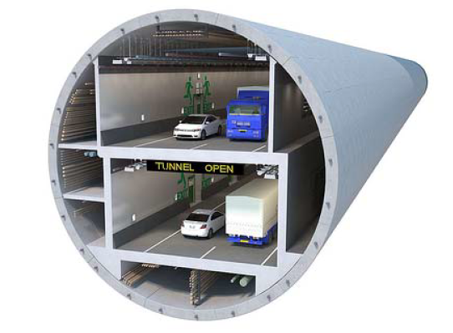
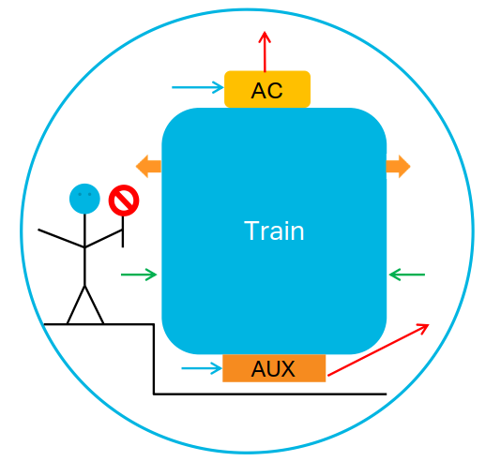
Tunnel Ventilation: An Overview
Purpose of ventilation
Temperature
Cooling
Auxiliary equipment
Air Quality
CO and fumes
Oxygen starvation (petrol / diesel)
Fire emergencies

Slide 7
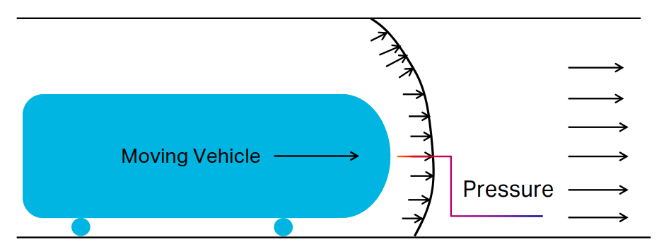
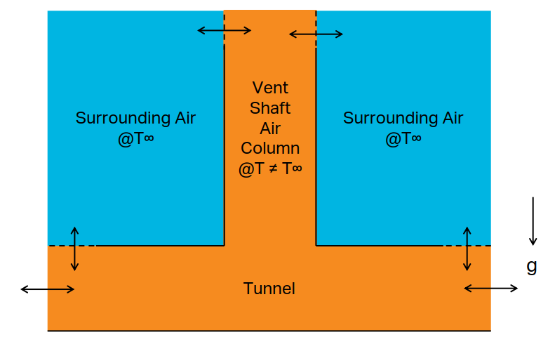
Tunnel Ventilation: An Overview
Piston Effect
Ventilation systems
Natural / Passive
Mechanical / Active
Natural / Passive
Piston effect
Wind
Chimney Effect
Chimney Effect

Slide 8
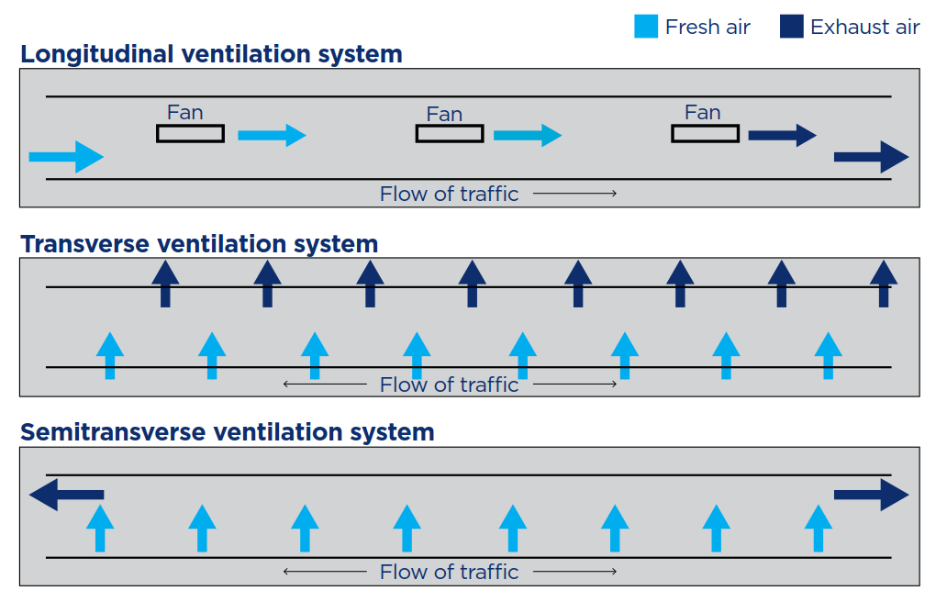
Tunnel Ventilation: An Overview
Ventilation systems
Natural / Passive
Mechanical / Active
Mechanical / Active
Transverse
Semi-transverse
Longitudinal
Roads and Maritime Services. TP04 Road Tunnel ventilation system, July 2014

Slide 9
Tunnel Ventilation Longitudinal Ventilation

Slide 10
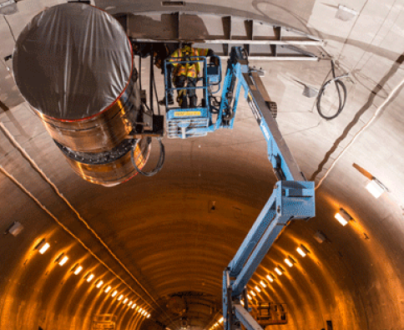
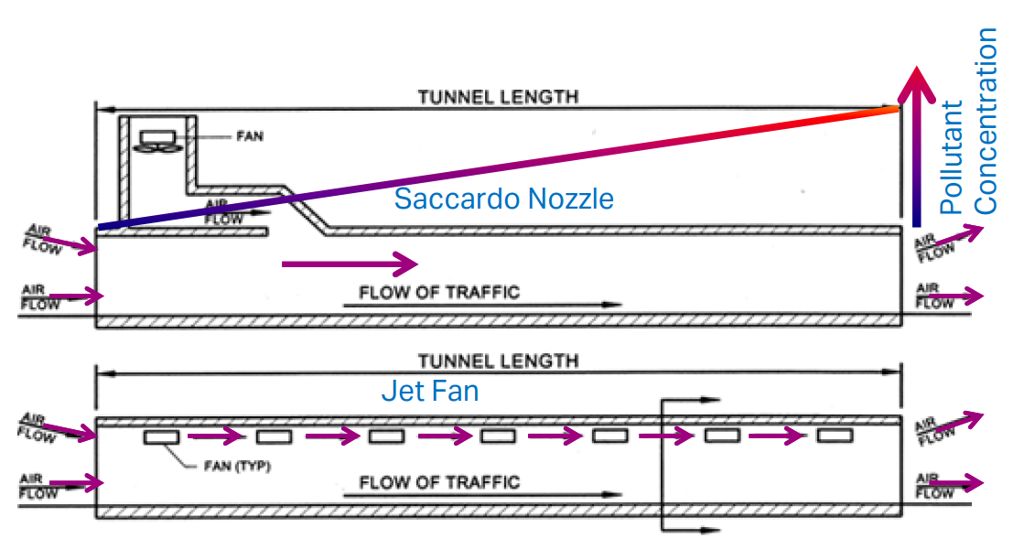
Tunnel Ventilation: Longitudinal Ventilation
Longitudinal ventilation
Air flow in one direction
Single direction traffic
Not viable previously; need for large quantities of fresh air
Used for the majority of tunnels in Australia last 20 years
Easier to construct than transverse systems

Slide 11
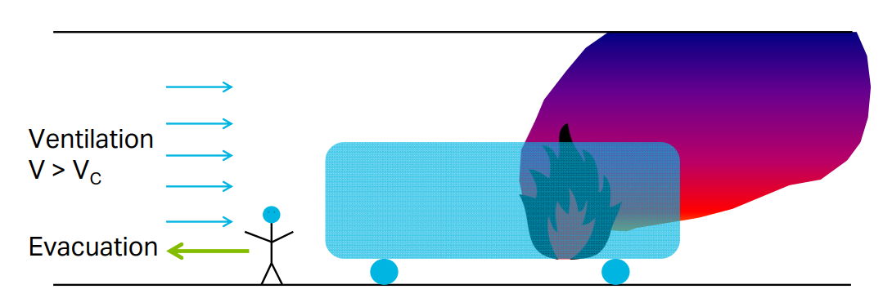
Tunnel Ventilation: Longitudinal Ventilation
Longitudinal ventilation in fire mode
Keep one side clear of the fire / smoke for evacuation
Air flow > critical ventilation velocity, Vc

Slide 12
Tunnel Ventilation: Longitudinal Ventilation
Longitudinal ventilation in fire mode
Keep one side clear of the fire / smoke for evacuation
Air flow > critical ventilation velocity, Vc
Backlayer: Air flow < Vc
No backlayer: Air flow > Vc
D. Swenson. Critical velocity in tunnel fires.
Thunderhead Engineering.

Slide 13
Tunnel Ventilation Critical Ventilation Velocity

Slide 14
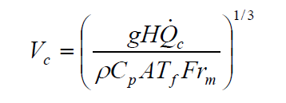
Tunnel Ventilation: Critical Ventilation Velocity
Velocity needed to prevent backlayering of smoke
One of the most studied phenomenon
1950s: Origins traced back to Thomas (Fire Research Station, UK)
Argued critical velocity governed by the ratio of buoyancy to inertial forces
Relationship linked by Froude Number
1970s: Refinements by Heselden
1980s: Refinements by Danziger and Kennedy
Related temperature to convective heat release rate
Cornerstone of tunnel ventilation design

Slide 15
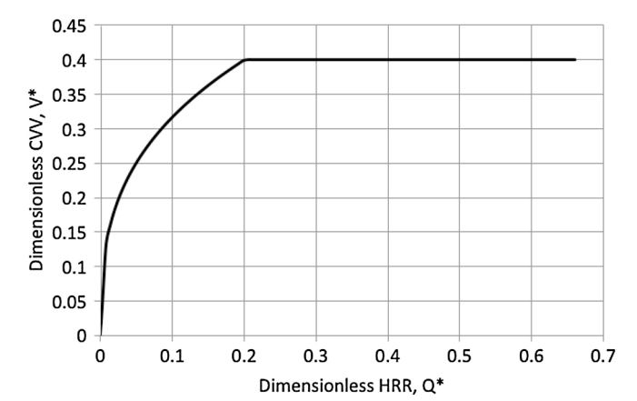
Tunnel Ventilation: Super Critical Ventilation Velocity
1995: Oka and Atkinson defined ‘super critical’ ventilation velocity
So what is the super critical ventilation velocity?
Fire size and critical velocity
Relationship up to a limit
No increase in velocity needed beyond
Typically ~ 3 to 4 m/s for road tunnels
A. Vaitkevicious and R. Carvel. Investigating the throttling effect in tunnel fires.
Fire Technology, June 2015

Slide 16
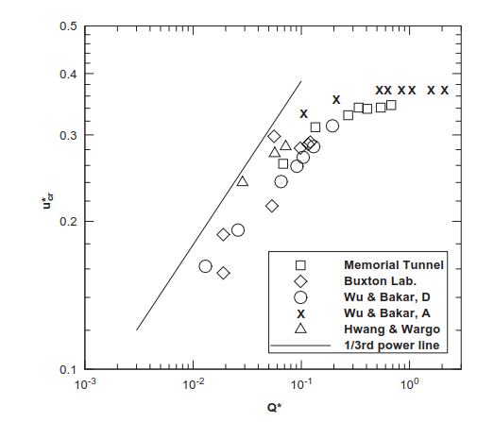
Tunnel Ventilation: Super Critical Ventilation Velocity
2000: Further refinements by Wu and Bakar
Further experiments showing this
Foundation of other researches
Tunnel dimensions
Relationship between velocity and fire growth
Slope in tunnels
Blockages in tunnels
Critical velocity near portals
Modified equation used today
NFPA 502 etc
C.C. Hwang and J.C. Edwards. The critical ventilation in tunnel fires .
Fire Safety Journal, 2002.

Slide 17
Fire Throttling Effect So how does it all relate?

Slide 18
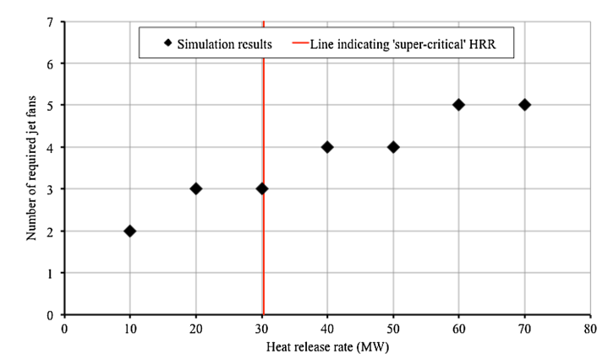
Tunnel Ventilation: Fire Throttling Effect
So what is the fire throttling effect?
An observed phenomenon where a fire increases the flow resistance
Pressure drop / flow resistance due to fires
A. Vaitkevicious and R. Carvel.
Investigating the throttling effect in tunnel fires.
Fire Technology, June 2015

Slide 19
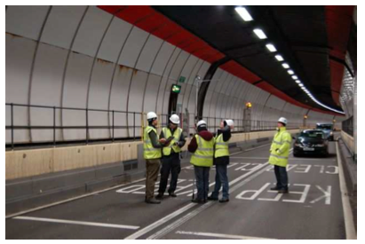
Tunnel Ventilation: Fire Throttling Effect
1973: First discussed for mining tunnels by Greuer
1979: Experimental observations by Lee
A forgotten and overlooked period
2014: Rediscovered by Colella et al whilst working on the novel multi-scale modelling approach for long tunnels
PIARC Jet Fan Calculation Procedure
A recognised phenomenon
To be verified in a CFD study

Slide 20
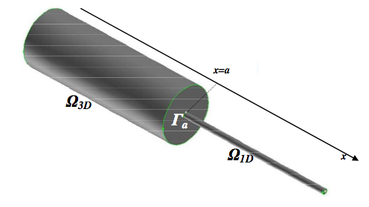
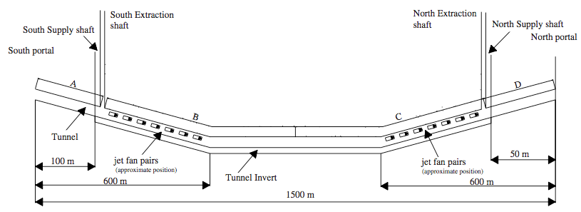
Tunnel Ventilation: Fire Throttling Effect
The impact of the fire throttling effect has been observed
No analytical or empirical model describing this
But a numerical glimpse in the FDS Multi-scale fire modelling work
Dartford Tunnel in London
F. Collela, R. Borchiellini, V. Verda, and G. Rein.
Multiscale Modelling of Tunnel Ventilation Flows and Fires.
[Online] https://www.era.lib.ed.ac.uk/handle/ 1842/3528, May 2010.
C.D.E. Ang, G. Rein, J. Peiro and R. Harrison
Simulating longitudinal ventilation flows in long tunnels CFD and Multi-scale modelling
Tunnellling and Underground Space Technology, February 2016

Slide 21
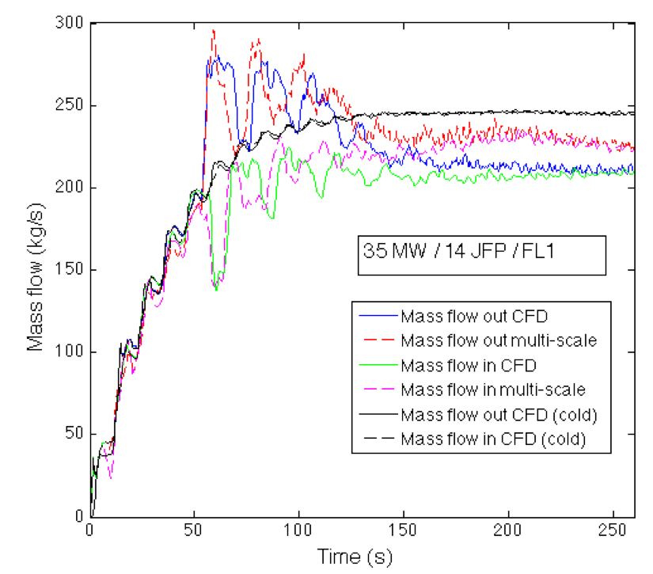
Tunnel Ventilation: Fire Throttling Effect
Reduction in mass flow

Slide 22
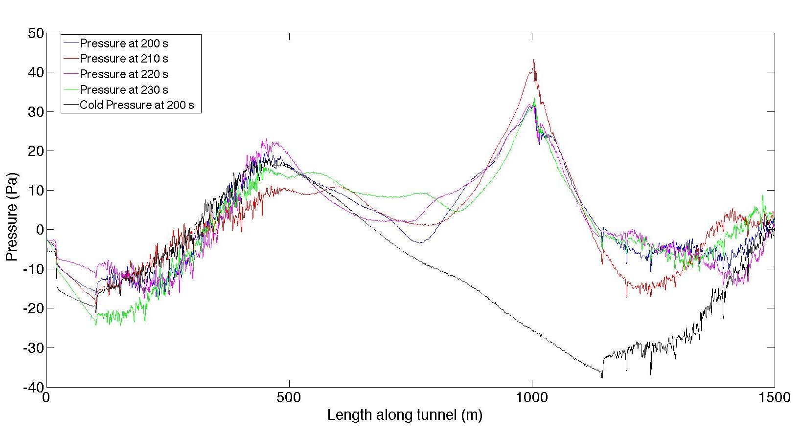
Tunnel Ventilation: Fire Throttling Effect
Throttling effect?
Jet fans
Jet fans
Cold flow pressure

Slide 23
Conclusion
Longitudinal tunnel ventilation will continue to be a popular means to ventilate a tunnel
Fire throttling effect is an important consideration
For a larger fire, the number of fans needed to achieve the critical velocity increases (the critical velocity remains unchanged)
We do not have an analytical or empirical description of this yet
Only through ‘black box’ CFD modelling – how accurate?
We are working on this – My PhD research!

Slide 24
Thank You
edmund.ang@aecom.com
chin.ang13@imperial.ac.uk
June, 2017

